Slide 1
Welcome back!
Meet the Teacher – Year Six

Slide 2

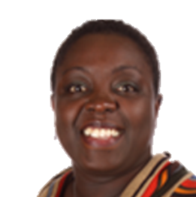
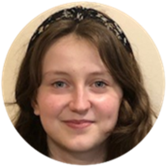
The Classroom Staff
Mrs Ofosu and Miss Hollis
Days that will be different are: Tuesday afternoon when Miss Bentley and Mr Billsby will teach alongside Miss Hollis.
Miss Hollis is in year 6 from Monday to Thursday.
Notes:
Tell staff who will be working with the class regularly and on which days. If you can, photos are good as not all parents will have seen the staff members before!!
Please include PPA cover

Slide 3
Our School Curriculum
Our curriculum has been redesigned this year to ensure that it meets the requirements of the national curriculum.
All subjects will be taught to pupils discretely so that they can articulate what they have learnt.
In addition, subjects will also support pupils to develop skills in the areas of our whole-school values and vision:
    Communication – how we can explain our ideas and challenge each other well.
    Spirituality – exploring spiritual and ethical issues.
    Cultural Capital – seeing and hearing the best that there is to see and hear.
There is more information on the curriculum page of the website.
Notes:
Explain our school curriculum focus

Slide 4
Our Curriculum this year
Information will be provided on our class page.
Autumn Term: Ancient Greece and The Maya, Animals including humans, Light, What the Quran Reveals, Incarnation
Spring Term: What is next for our world, Mapping, Electricity, Salvation
Summer Term: World War 2, All Living Things, Evolution, Creation
During the summer term, Year 6 will sit their SATs. There will be more information about this closer to the time but some of our morning and afternoon sessions will be dedicated to revision of key learning. This will be done in a way that is as fun as possible!
Notes:
Explain our school curriculum focus

Slide 5
Other things to look forward to…
We are hoping to be able to attend different sporting events this year, whether that is as part of a team or as a class. There will be some swimming sessions in the summer term on the school premises.
Trips
Sky Studios – as part of PSHE and literacy work on reports and presenting information.
Chesham Mosque – as part of RE and topic on Islam
Bletchley Park - to enhance our learning on World War 2
Our residential trip – this will happen in the summer term
Notes:
Explain our school curriculum focus

Slide 6
How you can help
Attendance – we need to be the best class! Please let us know if your child is unwell
Uniform
Skirts should be knee length. (small shorts underneath that can’t be seen, black or navy blue).
No jewellery (except for religious reasons)
stud earrings
1 pair of indoor shoes, 1 outdoor
Our PE days are Monday and Thursday.
Notes:
Homework – make it clear that we will not respond to each individual piece of work, but will as a whole. The following week, work may be tailored to address any issues or next steps from the previous week.

Slide 7
How you can help
Reading expectations – daily reading – please send the book in every day with a signed reading record.
Homework –Homework will go onto Google Classroom on Friday to be done by Monday.
Notes:
Homework – make it clear that we will not respond to each individual piece of work, but will as a whole. The following week, work may be tailored to address any issues or next steps from the previous week.

Slide 8
Any questions?

