Slide 1
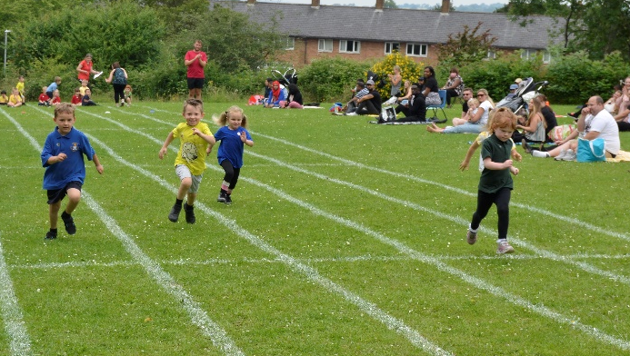
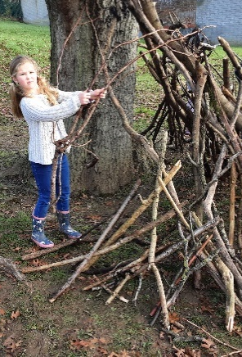
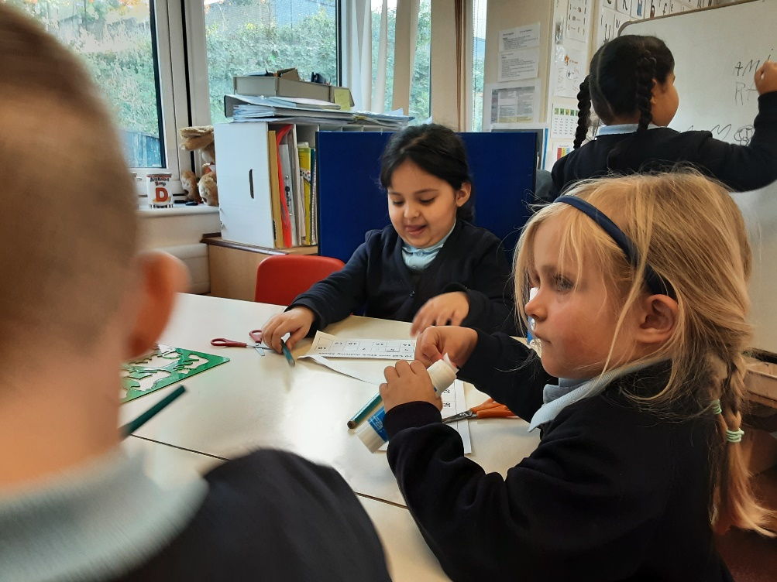
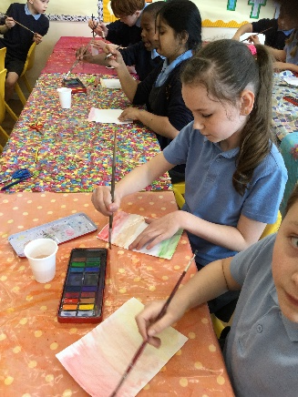
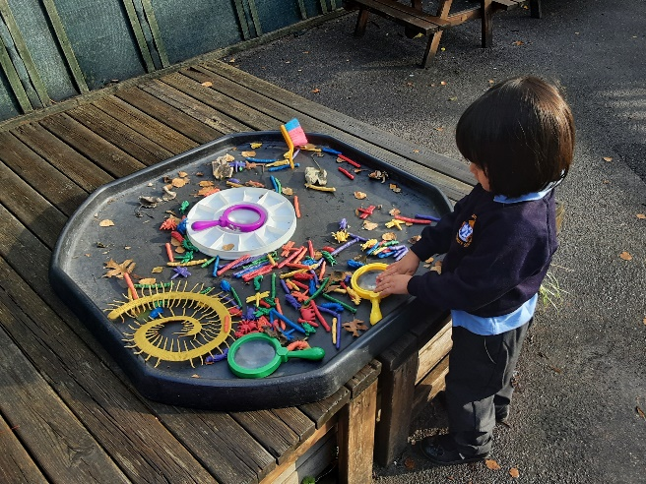
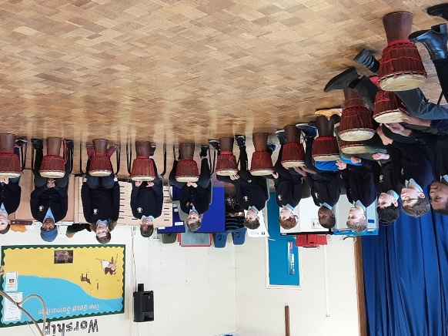
Welcome back!
Meet the Teacher – Year 2
September 2025

Slide 2

The Classroom Staff
Mrs Nicholls and Miss Jones
Mrs Cambridge,
Miss Gamage, Mrs Gabor and Mr Fancourt

Slide 3
Our School Curriculum
Our curriculum has been designed so that it meets the requirements of the national curriculum.
All subjects will be taught to pupils so we focus on the fundamental skills of disciplinary knowledge.
In addition, subjects will also support pupils to develop skills in the areas of our whole-school values and vision:
    Communication – how we can explain our ideas and challenge each other well.
    Spirituality – exploring spiritual and ethical issues.
    Cultural Capital – seeing and hearing the best that there is to see and hear.
There is more information on the curriculum page of the website.

Slide 4
Our Curriculum this year
Information will be provided on our class page.
Autumn Term:
History: The last 100 years
Science: Animals, including humans
RE: Teshuvah-Why do Jewish families talk about repentance at New Year?
-What is the good news that Jesus brings?
Computing:Computing systems and network IT around us
PE: Gymnastics and ball skills
Music: Pulse

Slide 5
Our Curriculum this year
Information will be provided on our class page.
Spring Term:
Geography: The Uk, Weather and oceans and continents
Science: Use of everyday materials
RE: How do Muslims show that Allah is merciful?
Why does Easter matter to Christians?
Computing: Creating media-Digital photography

Slide 6
Our Curriculum this year
Information will be provided on our class page.
Summer Term:
History/Geography: Fire of London and a local study of London
Science: Plants and All living things.
RE: What do Christians believe that God is like?
- Does completing Hajj make a person a better Muslim?
Computing: Programming - Robot algorithms

Slide 7
Other things to look forward to…
School trips! Tring museum, Roald Dahl museum and a trip to London.
Nativity
Swimming
Forest School

Slide 8
How you can help
Attendance – we need to be the best class! Please let us know if your child is unwell
Uniform (Our PE days are Wednedays and Fridays)
Reading expectations – daily reading – please send the book in every day with a signed reading record.
Homework – Reading, spellings and TTRS/Numbots

Slide 9
Just a reminder!
Parental Involvement
PTA – please email pta@nashmills.Herts.sch.uk if you would like to get involved.
Parents evening- After October half term
            -After Feb half term

