Slide 1
Welcome from Nash Mills PTA

Slide 2
What is the PTA?
The PTA is an open community of parent volunteers working alongside the school helping to ensure the best experience and facilities for all its pupils.
The PTA is a registered charity that is independent from the school.

Slide 3
How does the PTA benefit the school?
Parents and care givers have a big impact on how well their kids do at school. Taking an active role in your PTA is one of the ways you can make a difference and get involved:
We raise money to fund school initiatives through charity activities and events
We provide a social support network for parents
We provide volunteers and opportunities so that parents can support their child’s learning.

Slide 4
How does the PTA benefit the volunteers?
Gain new skills and experience
A chance to give back to the community
Meet new people
Build a stronger affinity with your child’s school
A sense of achievement and pride

Slide 5
Our Events Here’s a look at some of the fun we’ve had…

Slide 6
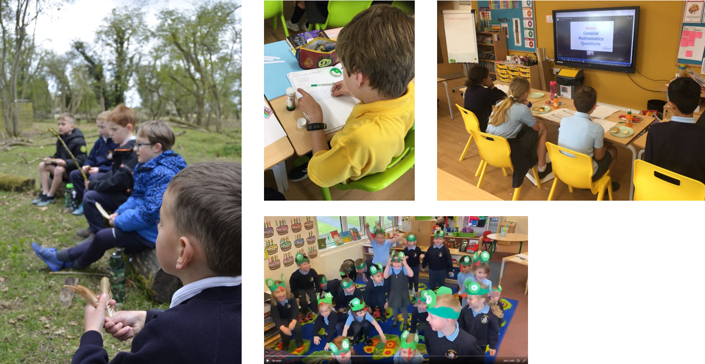
Our Success Our PTA’s fundraising activity has recently paid for…

Slide 7
Our Goals for 2021/22
Expand our volunteer network
Begin physical events again
Fund new staging and lighting equipment for school performances
Watching the kids having fun and benefiting

Slide 8
“How can my skills be useful?”
Any parent or caregiver can be a member, and everyone has skills to bring, from graphic design to gardening; from events management to balancing the books; and from wrapping up lucky dip gifts to handing out flyers!
Examples of how you can commit, either at an event or behind the scenes, include:
Design a logo
Contribute to the school newsletter
Become a class rep
Be our social media guru
Help at upcoming events
Bringing new fundraising ideas

Slide 9
“How much time do I have to commit?”
Some of our most active PTA members work full-time, or have other commitments
We all have lives away from school, and it’s OK to say “no”

Slide 10
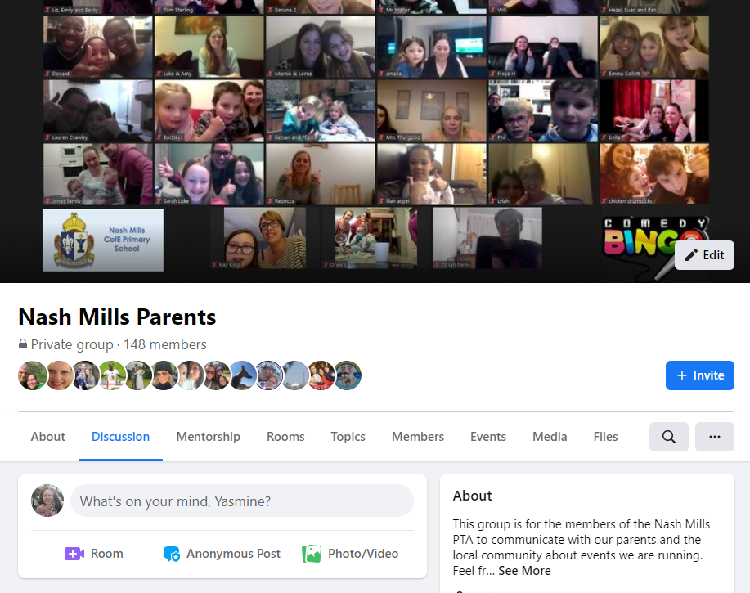
Get in Touch
Join our Facebook group:
Nash Mills Parents
Email us:
pta@nashmills.herts.sch.uk
Speak to your class reps

