Slide 1
Welcome
Multiplication/Maths Parents Information Evening
Wednesday 16th June 2021
Mrs Ofosu
Mathematics Subject Lead

Slide 2
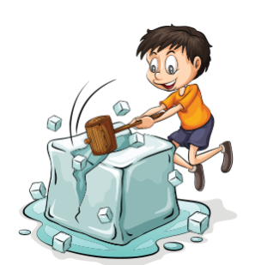
Answers: Use equivalent fractions to find answer.
X 2 X 3 X4
½ 2/8 and 7/16

Slide 3
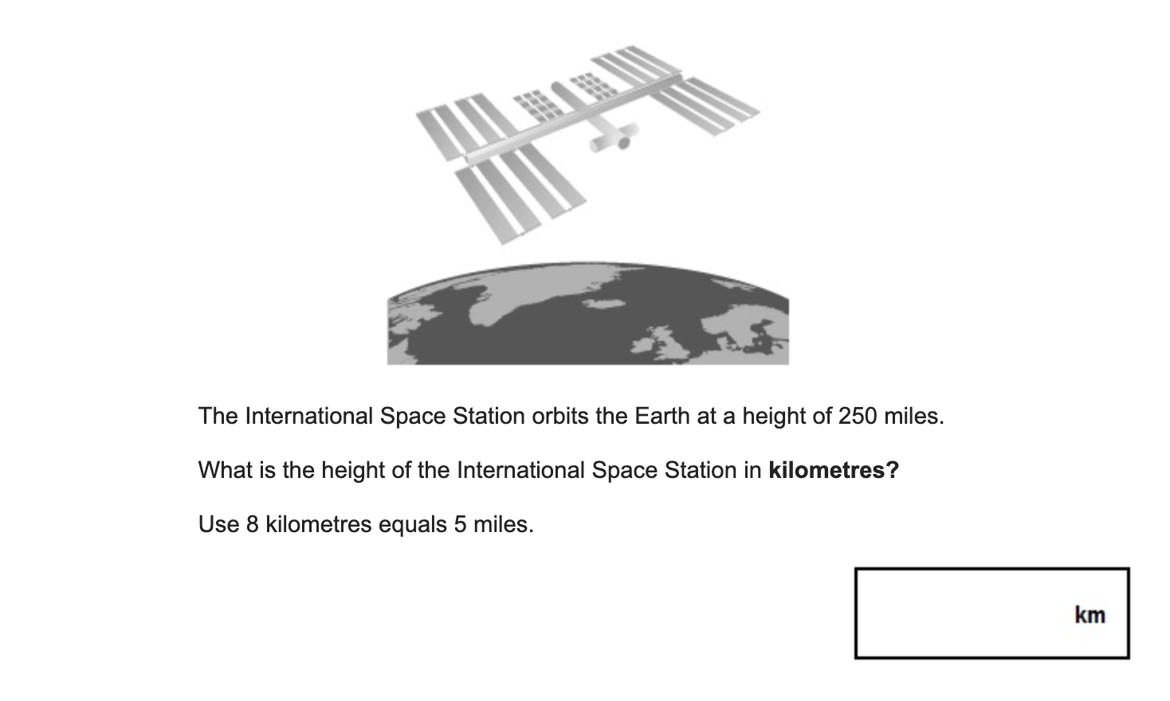
5 miles = 8 kilometers
5X 50 = 250 miles, so 8 X 50 = 400 kilometers

Slide 4
Maths at Nash Mills Primary School
In KS1 Mathematics lessons are held on a daily basis and last for approximately 50 minutes including a 5-10 minute daily fluency activity every day.
In KS2 the daily Mathematics lesson lasts for approximately 60 minutes including a 5-10 minute daily fluency activity every day.

Slide 5
Times Tables are vital to the curriculum throughout school.
Leaving primary school with a fundamental grasp of basic numeracy is as important as leaving being able to read. And just as the phonics check has helped more children learn to read, this will ensure more pupils know their times tables.”
Nick Gibb, Schools Minister

Slide 6
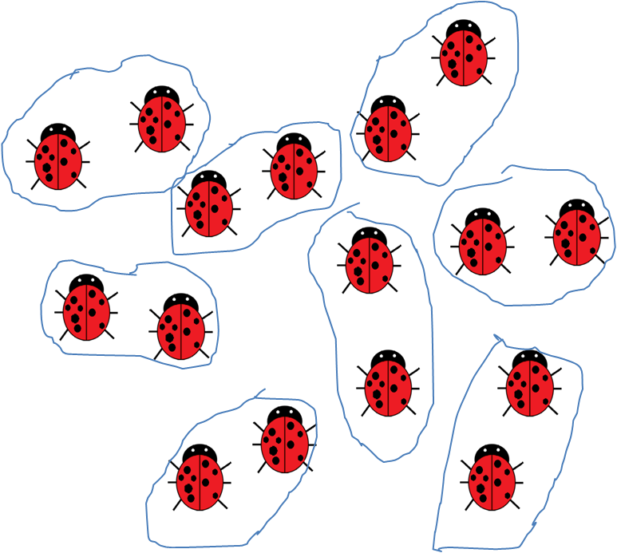
Times Tables are vital to the curriculum throughout school.
Reception and Year 1
Some children may start grouping objects in twos
Some children may count on or back in fives and tens

Slide 7
Times Tables are vital to the curriculum throughout school
Year 2
Know and recall multiplication and division facts for 2,5 and 10s
2 x 5 = 10
5 x 2 = 10
10 ÷ 2 = 5
10 ÷ 5 = 2

Slide 8
Times Tables are vital to the curriculum throughout school
Year 3
Know and recall multiplication and division facts for 3, 4 and 8
3 x 5 = 15
5 x 3 = 15
15 ÷ 3 = 5
15 ÷ 5 = 3
24 x 3

Slide 9
Times Tables are vital to the curriculum throughout school
Year 4
Know and recall multiplication and division facts for 6, 7, 9, 11 and 12
3 x 12 = 36
12 x 3 = 36
36 ÷ 3 = 12
36 ÷ 12 = 3
274 x 7
673 ÷ 7
23 x 10 x 3

Slide 10
Times Tables are vital to the curriculum throughout school
Year 5
Children are expected to be fluent in their times tables up to 12x by the end of Year 4.
Know and recall squared and cubed numbers ( 3 x 3 , 3 x 3 x 3)
4,623 x 45
4724 ÷ 8
40 x 700
5 x 90
What is one twelfth of 36?
Equivalent fractions

Slide 11
Times Tables are vital to the curriculum throughout school
Year 6
Children are expected to be fluent in their times tables up to 12x by the end of Year 4.
3624 x 76
3624 ÷ 65
What is nine tenths of 70?
What is 60% of 300?
What is 71% of 1800?
Ratio

Slide 12
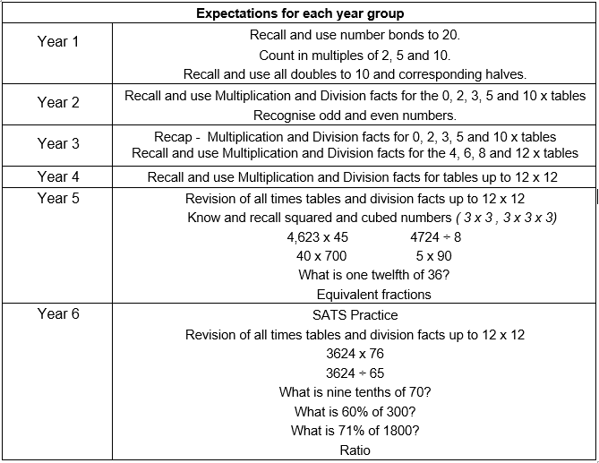
Summary of expectations:

Slide 13
Children who are not fluent in their times tables by the end of Year 4 will struggle to access the Year 5 and Year 6 curriculum, making learning new skills and concepts far more difficult.

Slide 14
Year 4 Multiplication Tables Check (MTC)
‘By the end of year 4, pupils should have memorised their multiplication tables up to and including the 12 multiplication table and show precision and fluency in their work’.
National Curriculum 2014
The MTC is a brand new statutory KS2 assessment to be taken by pupils at the end of Year 4. This sits alongside the existing end of KS2 SATs assessments in Year 6.
The MTC is focused on the fluent recall of multiplication facts ( 4 x 9 ).
The MTC will be delivered as an online, on-screen digital assessment and should take less than 5 minutes to complete. This will be taken in school on either a desktop computer or a tablet.

Slide 15
What will the assessment look like?
The assessment will take place over a three-week window in the summer term. Teachers can choose when the children will sit the times table check during that three-week window.
The children will be expected to answer 25 multiplication questions based on all tables up to 12x.
The children will be expected to do this in 6 seconds or less, meaning that quick recall of tables rather than working them out is essential.
The test will be scored automatically and will be marked out of 25. Data will be reported back to schools, parents and pupils as a score out of 25.
Children will only be considered to be fluent in their times tables if they achieve full marks in the assessment.

Slide 16
An example...

Slide 17
Access Arrangements
Access arrangements can be made for children who:
- have an Education, Health and Care (EHC) plan
- have an Individual Education Plan (IEP)
- have English as an additional language and have limited fluency in English

Slide 18
What if my child does not achieve full marks in the MTC?
The MTC will serve as a measure of how well children understand and can recall their times table knowledge.
Times tables are vital to the Year 5 and Year 6 curriculum and gaps in their knowledge will hold them back when completing work in Years 5 and 6.
Any child who does not achieve full marks in the MTC will receive further additional support in the form of interventions to plug any gaps in their times table knowledge in Years 5 and 6.
The MTC will serve as a helpful tool for teachers and schools in identifying children with gaps in their mathematical knowledge.

Slide 19
What are we doing to prepare children in school?
Times tables are taught every day as part of your child's maths lessons
All children have access to a Times Table Rock Stars account. This is an excellent online game where children are encouraged to practice their tables in a competitive way against peers, themselves or other members of the school
Teachers test times tables weekly to check where pupils are up to
Any children who are not secure with their times tables at different stages of the year receive interventions to help them catch up

Slide 20
How to help your child at home:
Every pupil in the school has been provided with a login for Times Tables Rock Stars and NumBots websites. They can access this on a laptop or a tablet.
https://ttrockstars.com/
https://play.numbots.com/#/intro
https://mathsframe.co.uk/
https://www.topmarks.co.uk/
https://www.bbc.co.uk/bitesize/subjects/zjxhfg8
https://www.oxfordowl.co.uk/for-home/kids-activities/times-table-activities/#TimesTableGames
There are some free maths games for the following websites:

Slide 21
How to help your child at home:
Quiz your children regularly and at random on their times tables. This could be done whilst cooking tea together, during car journeys or on the walk to school.
Show your children some fun 'tricks' for remembering the trickier times tables, like nines or the sevens.
Use times table wall charts at home.
Create flashcards with your child for each times table and play games like snap or matching them up in specific time. This works well as a competition between siblings, parents or even other family members!
Challenge your children to 'beat Siri' in their times tables!
Support school in any times table practice we send home.

Slide 22
And finally...
If you later on have any questions, please do speak to your child’s class teacher or you can send your queries to me through the school admin email.
Thank you for your time and support.

