Slide 1
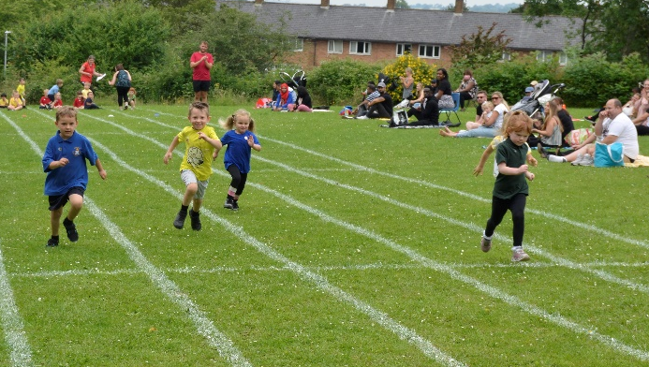
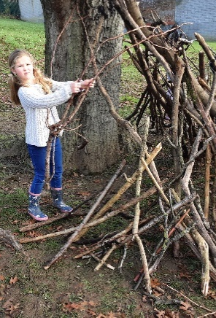
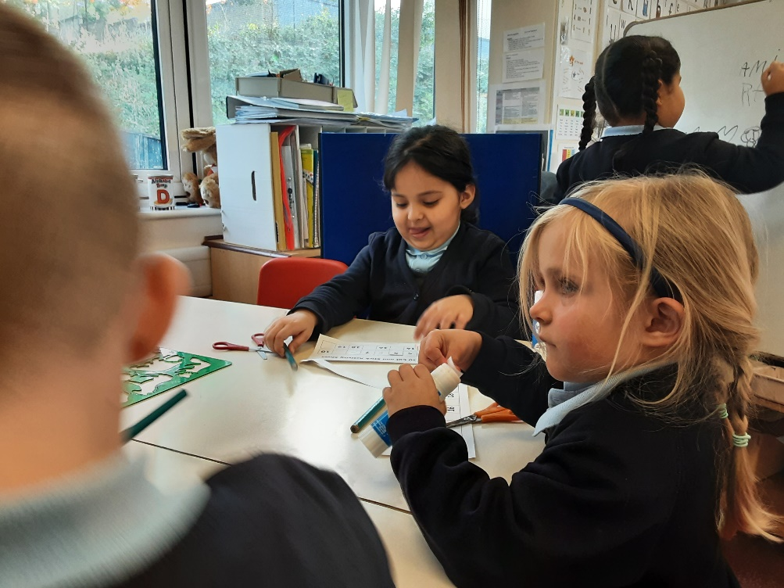
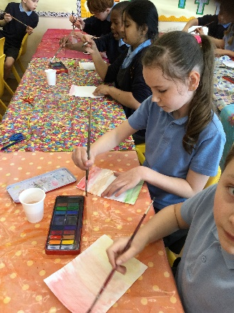
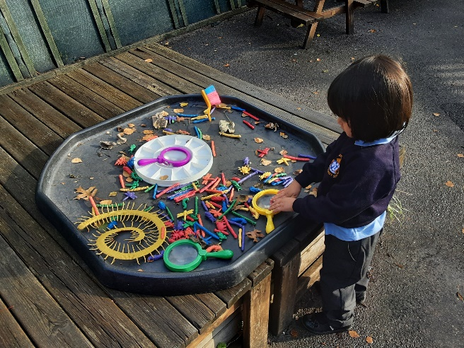
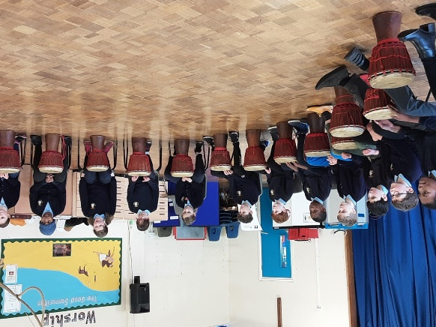
Welcome back!
Meet the Teachers – Year 4
September 2023

Slide 2

The Classroom Staff
Mrs Barrett Monday – Wednesday
Mr Shane– Thursday, Friday
Mrs Jakeman – Mon-Friday ☺
Notes:
Tell staff who will be working with the class regularly and on which days. If you can, photos are good as not all parents will have seen the staff members before!!
Please include PPA cover

Slide 3
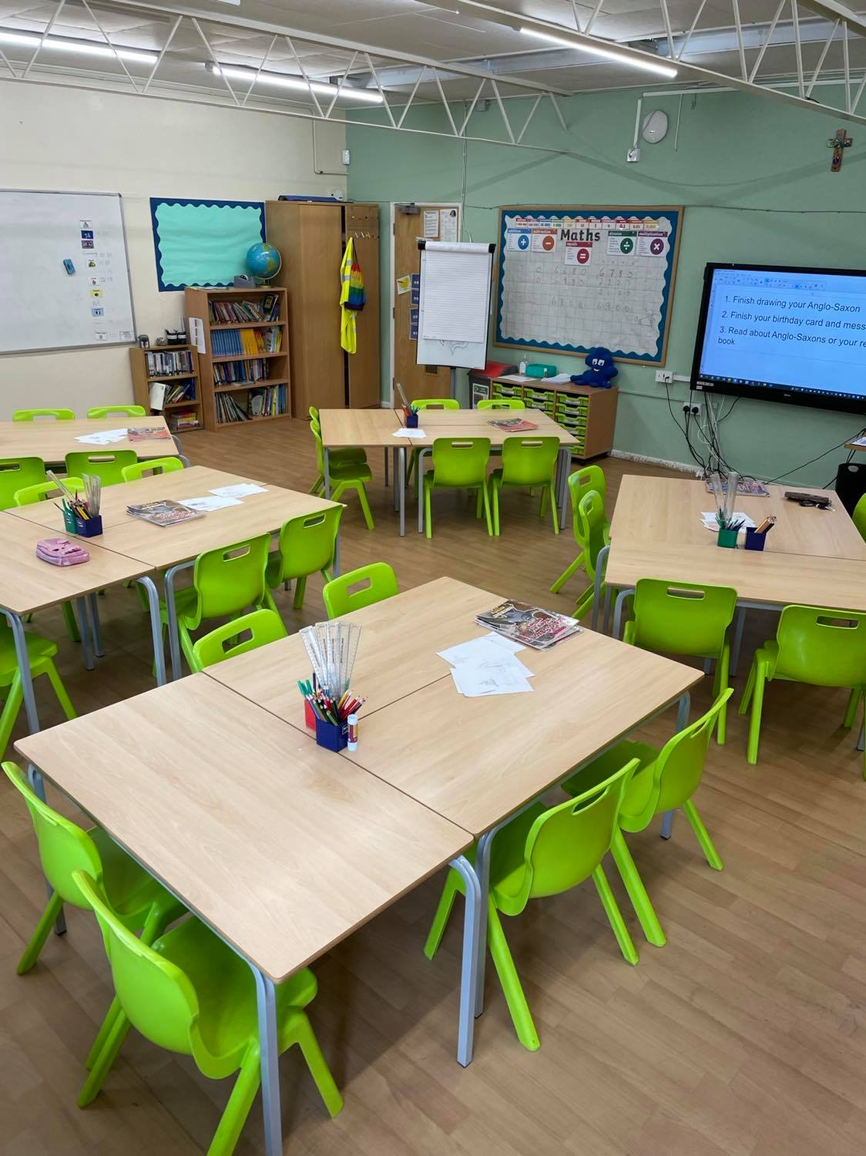
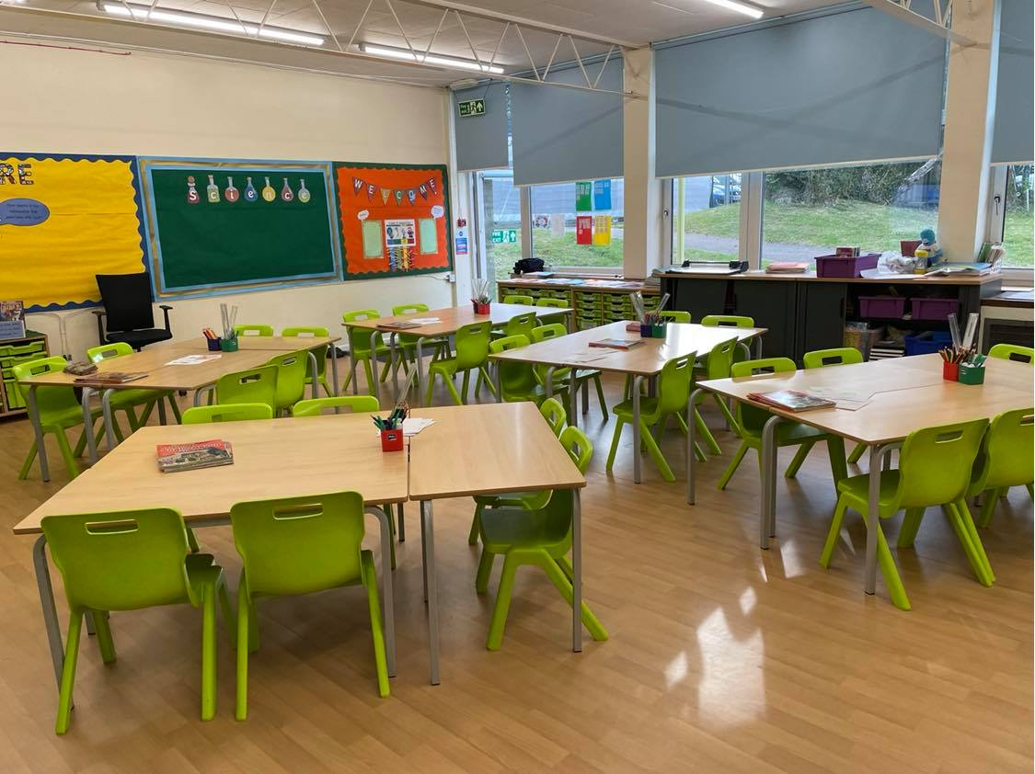
Our Classroom
Notes:
Highlight any key changes or main areas of learning and how the children will be able to use them.

Slide 4
Our School Curriculum
Our curriculum has been redesigned this year to ensure that it meets the requirements of the national curriculum.
All subjects will be taught to pupils discretely so that they can articulate what they have learnt.
In addition, subjects will also support pupils to develop skills in the areas of our whole-school values and vision:
    Communication – how we can explain our ideas and challenge each other well.
    Spirituality – exploring spiritual and ethical issues.
    Cultural Capital – seeing and hearing the best that there is to see and hear.
There is more information on the curriculum page of the website.
Notes:
Explain our school curriculum focus

Slide 5
Our Curriculum this year
Information will be provided on our class page.
Autumn Term: Anglo-Saxons
RE - Judaism, Followers of God
Science – Animals including humans, electricity
Spring Term: Rivers
RE – Hinduism, Easter
Science – States of Matter
Summer Term: Tudors and Local study
RE - Pentecost, Hinduism
Science – Living things, Sound
Notes:
Explain our school curriculum focus

Slide 6
Other things to look forward to…
Swimming
Mountfitchet Castle
Ukulele lessons
Times Tables National Assessment
Notes:
Explain our school curriculum focus

Slide 7
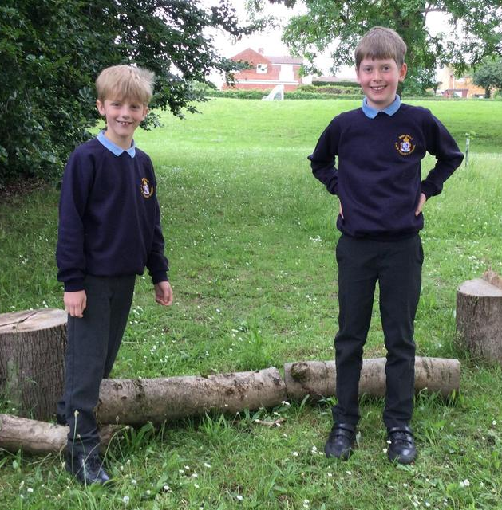
How you can help
Attendance – we need to be the best class! Please let us know if your child is unwell
Uniform (Our PE days are Wednesday and Friday)
Reading expectations – daily reading – please send the book in every day with a signed reading record.
Homework – home learning book
Notes:
Homework – make it clear that we will not respond to each individual piece of work, but will as a whole. The following week, work may be tailored to address any issues or next steps from the previous week.

Slide 8
Just a reminder!
Parental Involvement
PTA – please email pta@nashmills.Herts.sch.uk if you would like to get involved.
Communications – through admin@nashmills.herts.sch.uk

Slide 9
Any questions?

