Slide 1
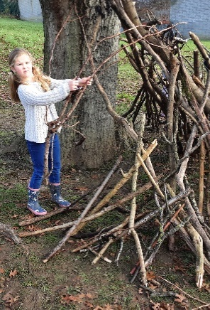
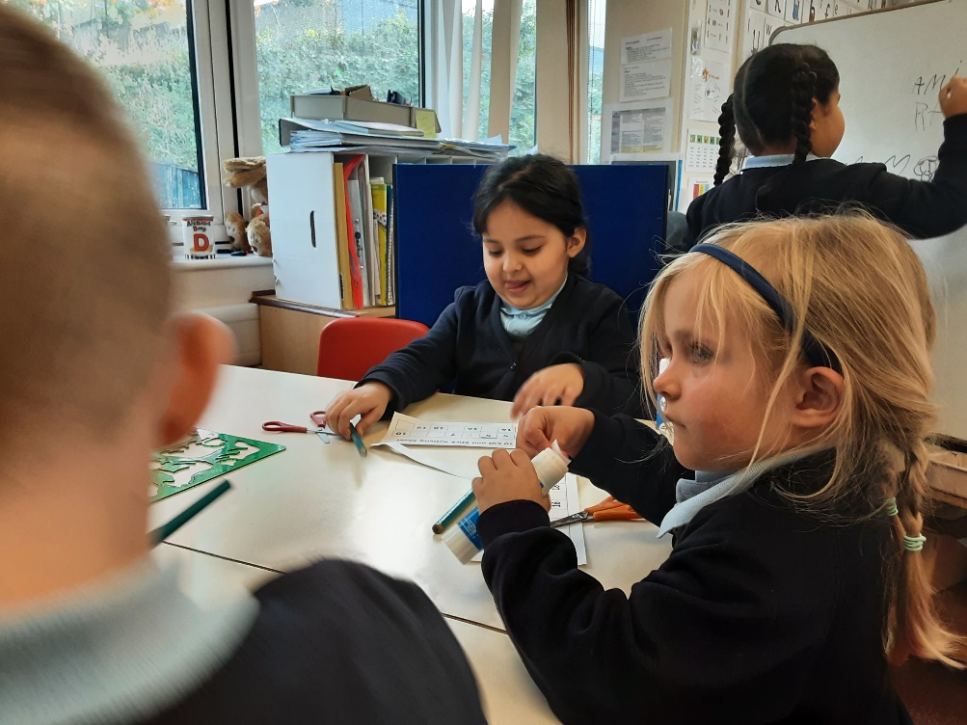
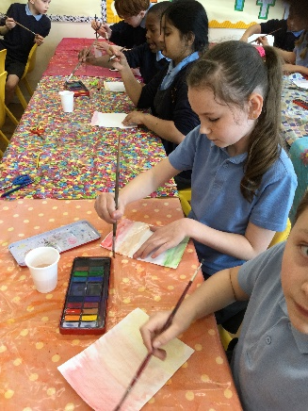
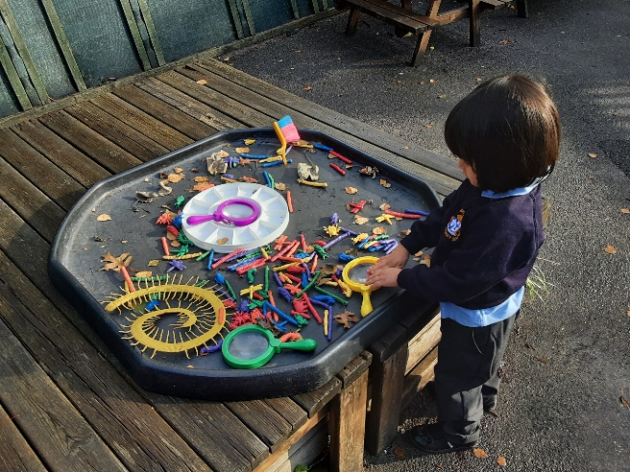
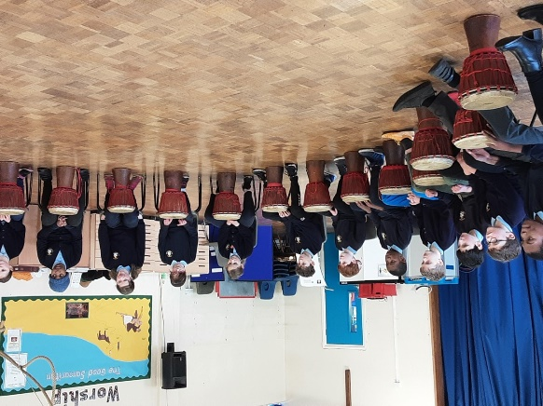
Welcome back!
Meet the Teacher – Year 3
September 2024

Slide 2
The Classroom Staff
Miss Lyden and Mrs Jakeman
Days that will be different are:
Monday afternoon – Mrs Jessop
Wednesday morning – Mrs Newman
Thursday afternoon – Miss Bentley and Miss Jones
Notes:
Tell staff who will be working with the class regularly and on which days. If you can, photos are good as not all parents will have seen the staff members before!!
Please include PPA cover

Slide 3
Our School Curriculum
Our curriculum has been redesigned this year to ensure that it meets the requirements of the national curriculum.
All subjects will be taught to pupils discretely so that they can articulate what they have learnt.
In addition, subjects will also support pupils to develop skills in the areas of our whole-school values and vision:
Communication – how we can explain our ideas and challenge each other well.
Spirituality – exploring spiritual and ethical issues.
Cultural Capital – seeing and hearing the best that there is to see and hear.
There is more information on the curriculum page of the website.
Notes:
Explain our school curriculum focus

Slide 4
Our Curriculum this year
Information will be provided on our class page.
Autumn Term:
Science: Animals, including humans and plants (forest school), light.
History: Stone Age to Iron Age.
RE: Islam – How do Muslims show their obedience to Allah / Christianity – What is the trinity?
PE: Netball and Dance/ gymnastics and hockey.
Computing: Computer systems/ creating media
Italian: Core vocabulary, days of the week and I am learning Italian.
Notes:
Explain our school curriculum focus

Slide 5
Our Curriculum this year
Information will be provided on our class page.
Spring Term:
Science: Rocks
Geography: Mapping, mountains and volcanoes
RE: Islam – Why do Muslims call Muhammad the ‘seal of the prophets’? / Christianity – Why do Christians call the day Jesus died ‘Good Friday’?
PE: Fitness and Tag Rugby/ OAA and dodgeball.
Computing: programming/ data and information
Italian: Seasons and I know how…
Notes:
Explain our school curriculum focus

Slide 6
Our Curriculum this year
Information will be provided on our class page.
Summer Term:
Science: Forces and Magnets.
History: Romans
RE: Christianity –What is it like to follow God?/ What do Christians learn from the creation story?.
PE: Tennis and Cricket/ Athletics and rounders
Computing: Creating and programming
Italian: Shapes and ice cream.
Notes:
Explain our school curriculum focus

Slide 7
Other things to look forward to…
Trips:
Autumn - Pizza Express, Lee Valley and Chesham mosque
Spring – Hudnall park and a Y3/4 production.
Summer – Verulamium.
Swimming
Notes:
Explain our school curriculum focus

Slide 8
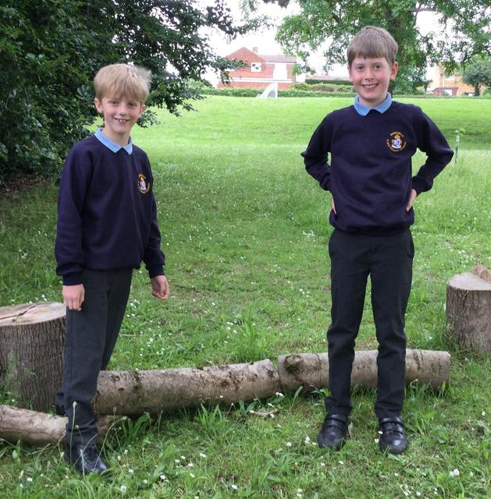
How you can help
Attendance – we need to be the best class! Please let us know if your child is unwell
Uniform
Skirts should be knee length. (small shorts underneath that can’t be seen, black or navy blue).
No jewellery (except for religious reasons)
stud earrings
1 pair of indoor shoes, 1 outdoor
Our PE days are Tuesday and Thursday.
Notes:
Homework – make it clear that we will not respond to each individual piece of work, but will as a whole. The following week, work may be tailored to address any issues or next steps from the previous week.

Slide 9
How you can help
Reading expectations – daily reading – please send the book in every day with a signed reading record.
Homework – Children should be reading, doing their spellings and practicing maths every week. A homework grid is in their books and should be handed in on a Wednesday to hand back on a Thursday.
Notes:
Homework – make it clear that we will not respond to each individual piece of work, but will as a whole. The following week, work may be tailored to address any issues or next steps from the previous week.

Slide 10
Just a reminder!
Parental Involvement
PTA – please email pta@nashmills.Herts.sch.uk if you would like to get involved.
Parents evening – after October half term and after February half term.

Slide 11
Any questions?

