Slide 1
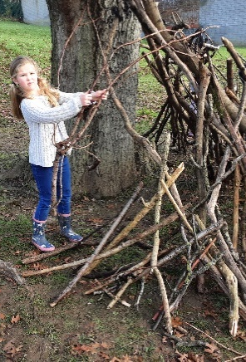
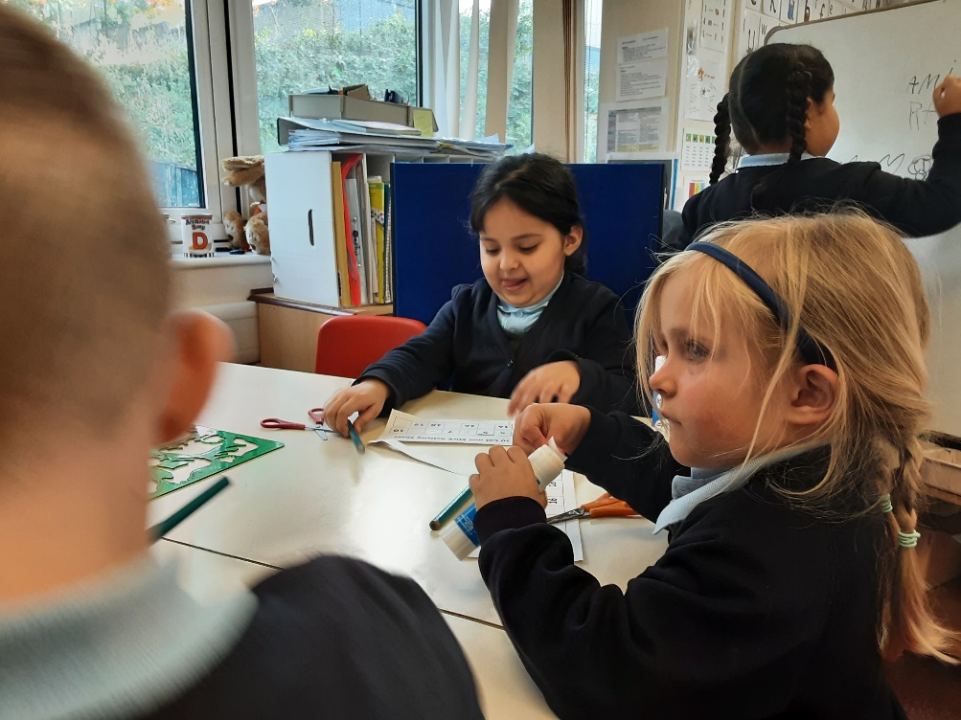
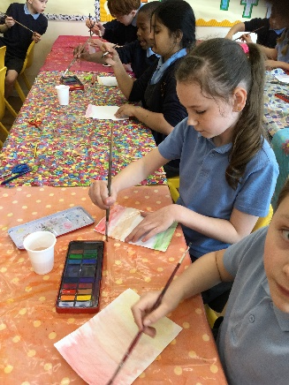
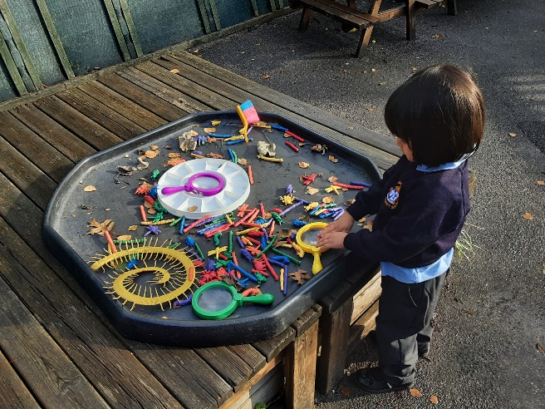
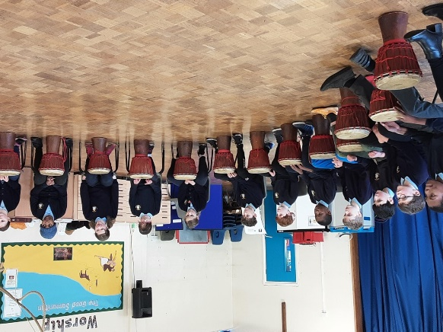
Welcome back!
Meet the Teacher – Year 2
September 2024

Slide 2
The Classroom Staff
Mrs Nicholls
Mrs Cambridge, Miss Hatting and Miss Bentley
Notes:
Tell staff who will be working with the class regularly and on which days. If you can, photos are good as not all parents will have seen the staff members before!!
Please include PPA cover

Slide 3
Our School Curriculum
Our curriculum has been designed so that it meets the requirements of the national curriculum.
All subjects will be taught to pupils so we focus on the fundamental skills of disciplinary knowledge.
In addition, subjects will also support pupils to develop skills in the areas of our whole-school values and vision:
Communication – how we can explain our ideas and challenge each other well.
Spirituality – exploring spiritual and ethical issues.
Cultural Capital – seeing and hearing the best that there is to see and hear.
There is more information on the curriculum page of the website.
Notes:
Explain our school curriculum focus

Slide 4
Our Curriculum this year
Information will be provided on our class page.
Autumn Term:
History: The last 100 years
Science: Animals, including humans, All living things
RE: Teshuvah-Why do Jewish families talk about repentance at New Year?
-What is the good news that Jesus brings?
Computing:Computing systems and network IT around us
PE: Gymnastics and ball skills
Music: Pulse
Notes:
Explain our school curriculum focus

Slide 5
Our Curriculum this year
InInformation will be provided on our class page.
Spring Term:
Geography: The Uk, Weather and oceans and continents
Science: Use of everyday materials
RE: How do Muslims show that Allah is merciful?
-Why does Easter matter to Christians?
Computing: Creating media-Digital photogrphy
Notes:
Explain our school curriculum focus

Slide 6
Our Curriculum this year
Information will be provided on our class page.
Summer Term:
History/Geography: Fire of London and a local study of London
Science: Plants
RE: What do Christians believe that God is like?
- Does completing Hajj make a person a better Muslim?
Computing: Programming - Robot algorithms
Notes:
Explain our school curriculum focus

Slide 7
Other things to look forward to…
School trips! Tring museum, Roald Dahl museum and a trip to London.
Nativity
Swimming
Forest School
Notes:
Explain our school curriculum focus

Slide 8
How you can help
Attendance – we need to be the best class! Please let us know if your child is unwell
Uniform (Our PE days are Mondays and Friddays)
Reading expectations – daily reading – please send the book in every day with a signed reading record.
Homework – Homework menu in a book, TTRS/Numbots
Notes:
Homework – make it clear that we will not respond to each individual piece of work, but will as a whole. The following week, work may be tailored to address any issues or next steps from the previous week.

Slide 9
Just a reminder!
Parental Involvement
PTA – please email pta@nashmills.Herts.sch.uk if you would like to get involved.
Parents evening- After October half term
-After Feb half term

