Slide 1
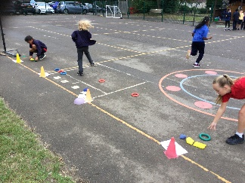
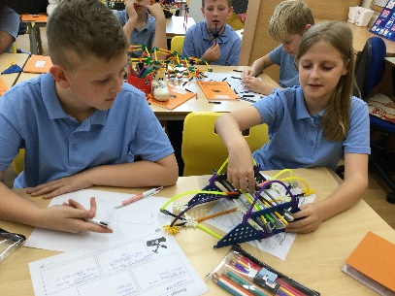
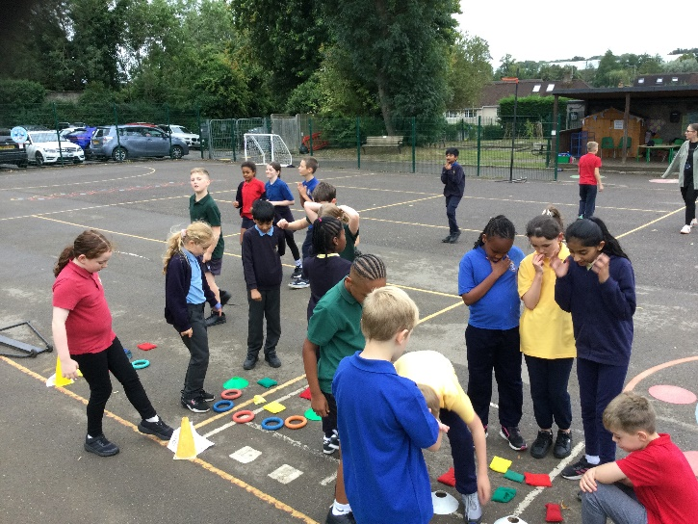
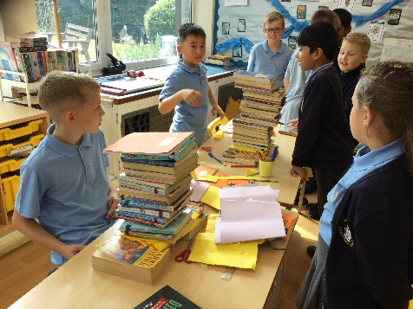
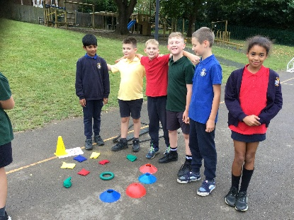
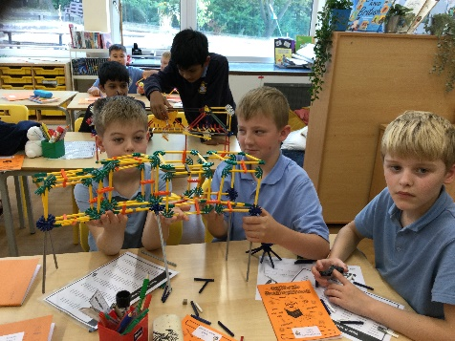
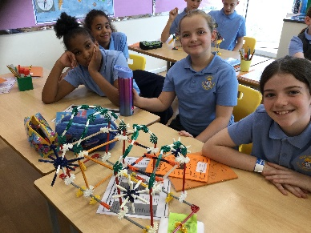
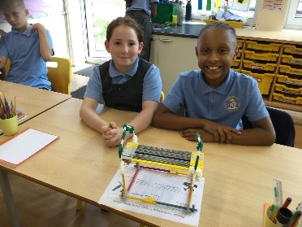
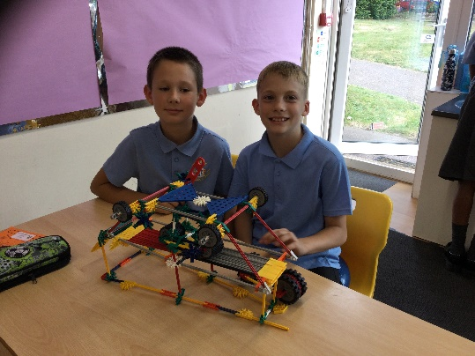
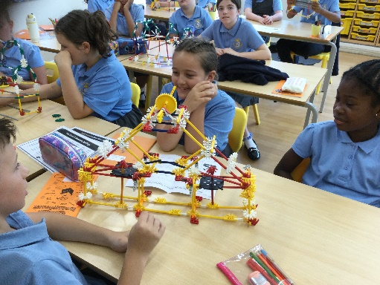
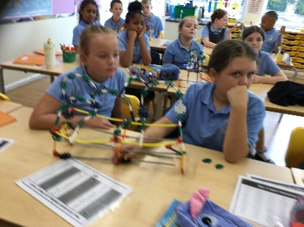
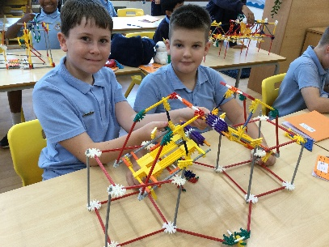
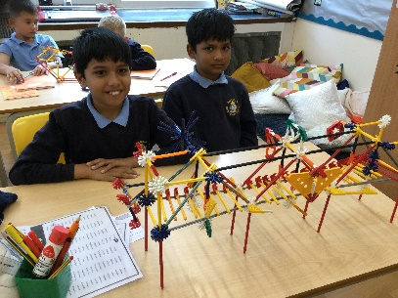
Welcome back!
Meet the Teacher – Year 5

Slide 2
The Classroom Staff
Mrs Lewis
Miss Finnis
Days that will be different are:
Thursday afternoon Miss Bentley and Miss Finnis
Notes:
Tell staff who will be working with the class regularly and on which days. If you can, photos are good as not all parents will have seen the staff members before!!
Please include PPA cover

Slide 3
Our School Curriculum
Our curriculum has been redesigned to ensure that it meets the requirements of the national curriculum.
All subjects will be taught to pupils discretely so that they can articulate what they have learnt.
In addition, subjects will also support pupils to develop skills in the areas of our whole-school values and vision:
Communication – how we can explain our ideas and challenge each other well.
Spirituality – exploring spiritual and ethical issues.
Cultural Capital – seeing and hearing the best that there is to see and hear.
There is more information on the curriculum page of the website.
Notes:
Explain our school curriculum focus

Slide 4
Our Curriculum this year
Information will be provided on our class page.
Autumn Term: Egyptians, All living things, Space, Humanism
Spring Term: Rainforests, mapping skills, salvation, space, forest school
Summer Term: animals including humans, people of God, Victorians
Notes:
Explain our school curriculum focus

Slide 5
Other things to look forward to…
Local walks with map reading / Orienteering
British Museum
Kew gardens
Residential!
Notes:
Explain our school curriculum focus

Slide 6
How you can help
Attendance – Please let us know if your child is unwell
Uniform
Skirts should be grey and knee length.
No jewellery (except for religious reasons)
Stud earrings
1 pair of indoor shoes, 1 outdoor
Our PE days - Tuesday and Thursday
Plain navy jumpers – not branded tracksuit tops.
School jumpers are fine for PE.

Slide 7
How you can help
Reading expectations – daily reading independently or to someone at home. Children can record their reading independently – please send signed reading record every day.
Book reviews.
Homework – Google Classroom, hand in by Monday each week. Always what we have done in class for maths
Times tables rockstars – independent practise.
Notes:
We’ve set ourselves the challenge of doing book reviews evert time we read a new book, critiquing it and giving it a star rating.
Homework – make it clear that we will not respond to each individual piece of work, but will as a whole. The following week, work may be tailored to address any issues or next steps from the previous week.

Slide 8
Just a reminder!
Parental Involvement
PTA – please email pta@nashmills.Herts.sch.uk if you would like to get involved.

