Slide 1
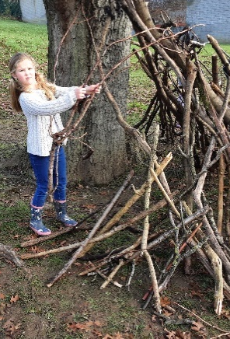
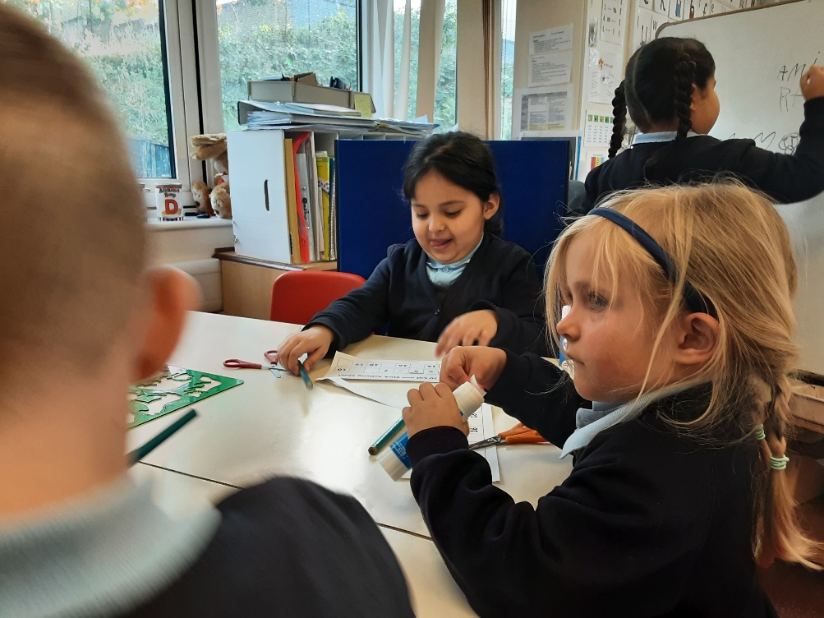
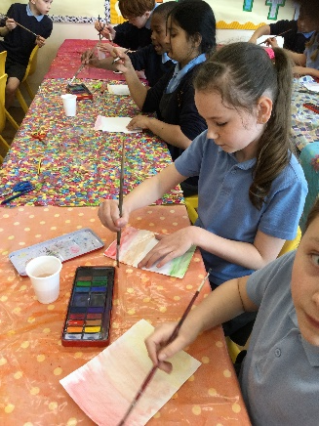
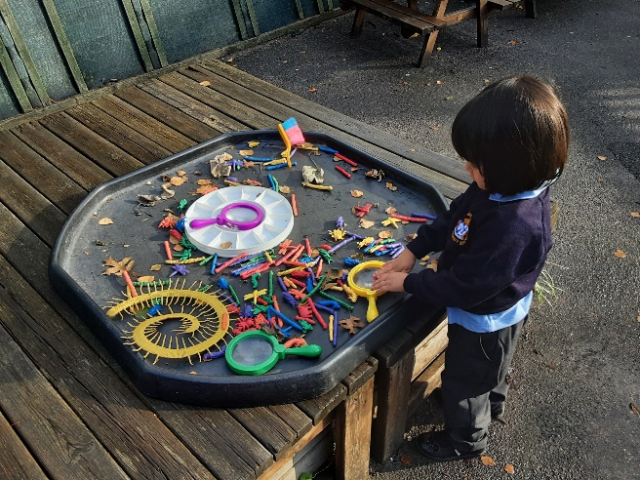
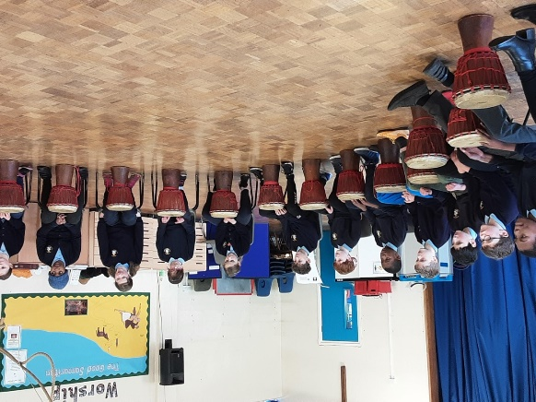
Welcome back!
Meet the Teacher – Year R
September 2023

Slide 2
The Reception team
Mrs Wilson with
Ms Bolton, Ms Gamage,
Ms Hollis (Mon-Thurs)
Ms Impey (afternoons) and
Ms Powell.
Days that will be different are: Tuesday afternoons, which will be
covered by Ms Bolton and Ms Powell.
Notes:
Tell staff who will be working with the class regularly and on which days. If you can, photos are good as not all parents will have seen the staff members before!!
Please include PPA cover

Slide 3
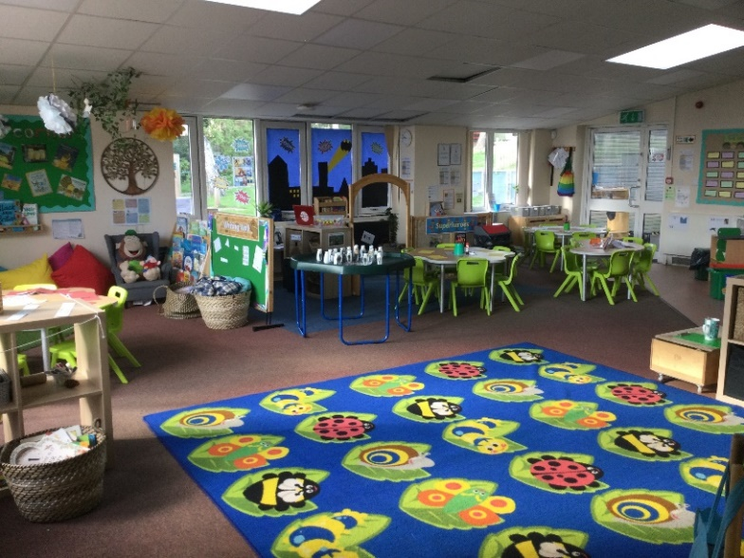
Our Classroom
We have various areas in our classroom, which include a reading/reflection space, a maths area, a writing area, a music area, a craft area, an exploration space and a role play area.
Notes:
Highlight any key changes or main areas of learning and how the children will be able to use them.

Slide 4
Our School Curriculum
Our curriculum is designed to ensure that it meets the requirements of the national curriculum.
All subjects will be taught to pupils discretely so that they can articulate what they have learnt.
In addition, subjects will also support pupils to develop skills in the areas of our whole-school values and vision:
Communication – how we can explain our ideas and challenge each other well.
Spirituality – exploring spiritual and ethical issues.
Cultural Capital – seeing and hearing the best that there is to see and hear.
There is more information on the curriculum page of the website.
Notes:
Explain our school curriculum focus

Slide 5
Our Curriculum this year
Our topics are as follows:
Aut Term 1: All about me – family, friends, our community
Aut Term 2: Space – planets, life on the moon & astronauts
Christmas – including a nativity play
Spr Term 1: Fairy tales – Traditional tales, story telling and knights & dragons
Spr Term 2: The Zoo – Animals both in the zoo and in their own habitats, endangered species.
Easter – thinking about the Easter story
Sum Term 1: Superheroes - including people that help us
Sum Term 2: Beach – above and under the oceans and the dangers of plastic in the sea
Notes:
Explain our school curriculum focus

Slide 6
Other things happening…
Annual trips – include Hemel library, local parks and the shops, the zoo, Ruislip Lido and walks to the local care home.
Nativity play – Reception will team up with Nursery to produce a Christmas play for parents to come and see.
Forest School – we will have Forest School every Thursday for three half terms.
Italian – we will have Italian taught by a teacher from Italy.
Swimming – Reception will join the rest of the school for lessons in June
Notes:
Explain our school curriculum focus

Slide 7
How you can help
Attendance – Please let us know by 9am if your child is unwell.
Correct Uniform (except for Tuesdays when children should wear their PE kit). No jewelry or watches please.
Reading expectations – Please read school phonics books daily to your child and sign your child’s reading record afterwards.
Home learning – We will send home activities every half term for your child to complete each week. The grid will have nine simple ideas of things to do with your child. Pick the one you like the most and record it in your Home learning book, which should be handed in every Wednesday.
Notes:
Homework – make it clear that we will not respond to each individual piece of work, but will as a whole. The following week, work may be tailored to address any issues or next steps from the previous week.

Slide 8
Just a reminder!
Parental Involvement
PTA – please email pta@nashmills.herts.sch.uk if you would like to get involved. We enjoy working closely with parents to make our school a better place.
Governors – we welcome parents who would like to help with the governance of the school and join our existing team.

Slide 9
Any questions?
Please speak to any of the early years team and we will do our best to help.

