Slide 1
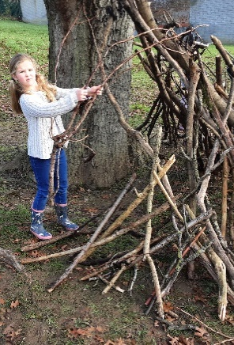
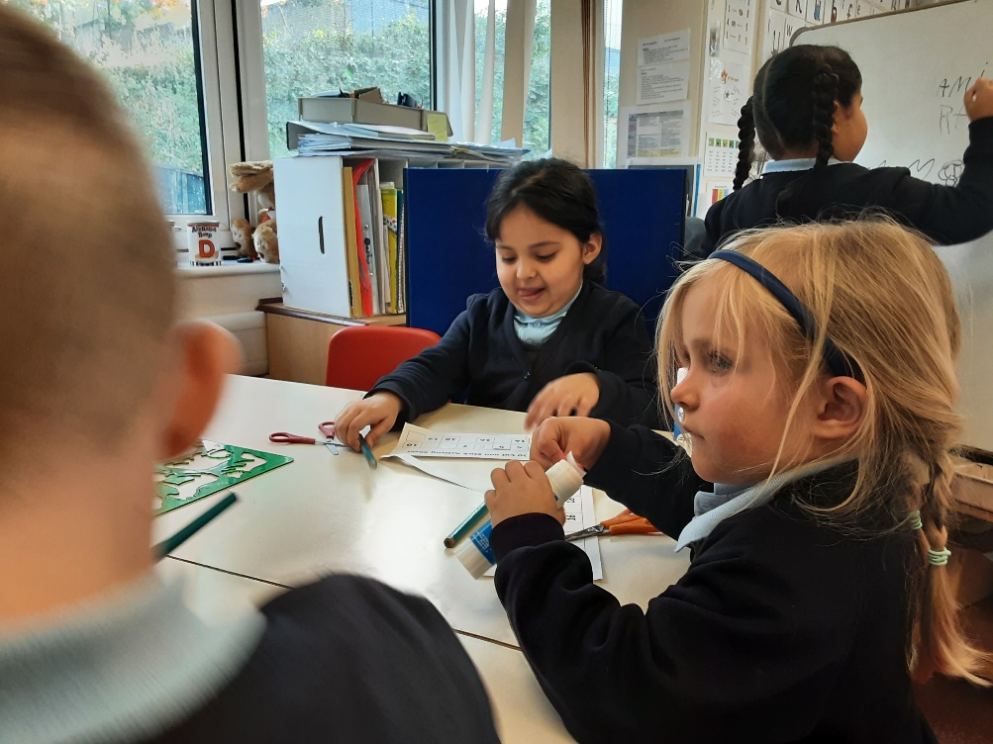
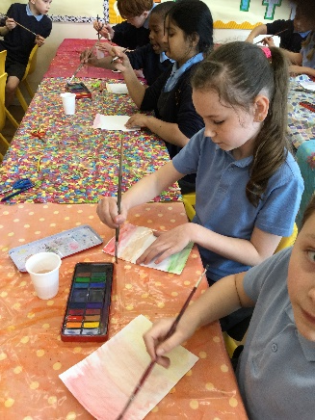
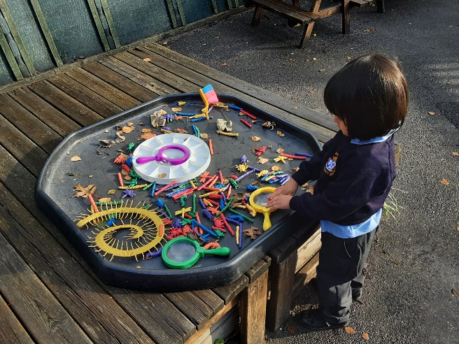
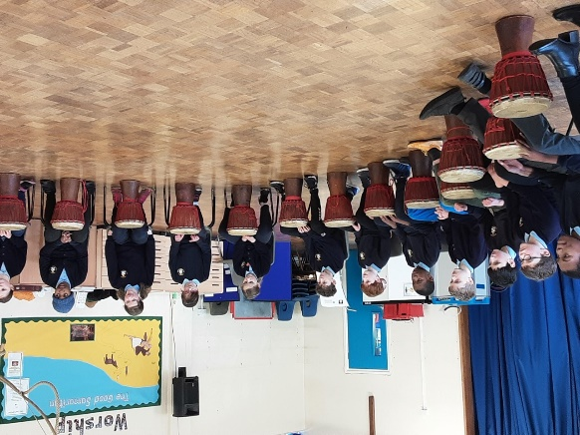
Welcome back!
Meet the Teacher – Year 1
September 2024

Slide 2
The Classroom Staff
Miss Brewer, Mrs Ahktar, Miss Hollis, Mrs Impey and Mrs Gamage
Days that will be different are Thursdays: Miss Bentley will teach Forest school in the after noon, and a sports coach will teach PE.
Notes:
Tell staff who will be working with the class regularly and on which days. If you can, photos are good as not all parents will have seen the staff members before!!
Please include PPA cover

Slide 3
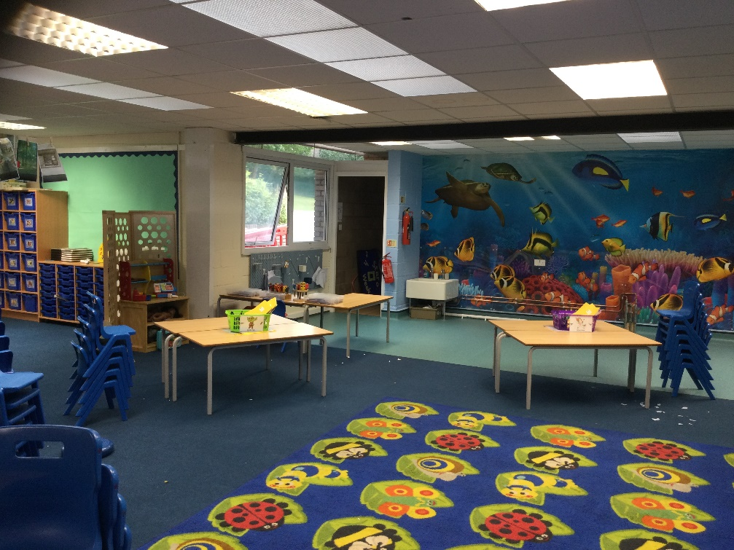
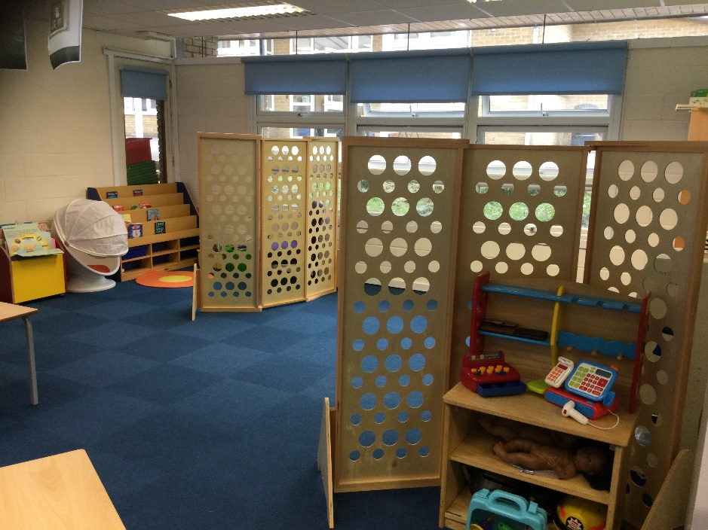
Our Classroom
Notes:
Highlight any key changes or main areas of learning and how the children will be able to use them.

Slide 4
Our School Curriculum
Our curriculum has been redesigned this year to ensure that it meets the requirements of the national curriculum.
All subjects will be taught to pupils discretely so that they can articulate what they have learnt.
In addition, subjects will also support pupils to develop skills in the areas of our whole-school values and vision:
Communication – how we can explain our ideas and challenge each other well.
Spirituality – exploring spiritual and ethical issues.
Cultural Capital – seeing and hearing the best that there is to see and hear.
There is more information on the curriculum page of the website.
Notes:
Explain our school curriculum focus

Slide 5
Other things to look forward to…
Mead Open Farm in Autumn term.
Royal Air Force Museum in Summer term and swimming!
Notes:
Explain our school curriculum focus

Slide 6
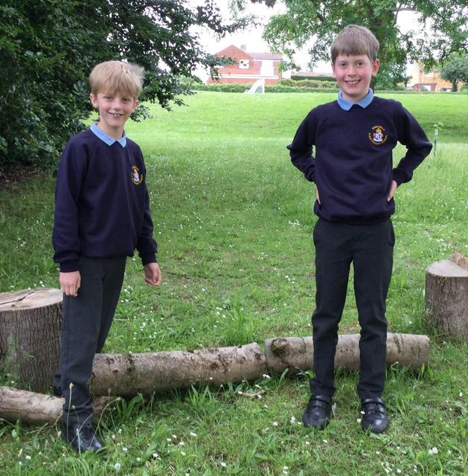
How you can help
Attendance – we need to be the best class! Please let us know if your child is unwell
Uniform – Please follow our uniform policy.
PE kits on Wednesdays and Thursdays
Reading expectations – daily reading – please send the book in every day with a signed reading record.
Homework – Will be sent home on Fridays and due back on Wednesdays.
Notes:
Homework – make it clear that we will not respond to each individual piece of work, but will as a whole. The following week, work may be tailored to address any issues or next steps from the previous week.

Slide 7
Just a reminder!
Parental Involvement
PTA – please email pta@nashmills.Herts.sch.uk if you would like to get involved.
Governors – we will shortly be looking for a few new governors.
We have some parent learning sessions planned for this term. More information to follow.

Slide 8
Please come and see us if you have any questions!

