Slide 1
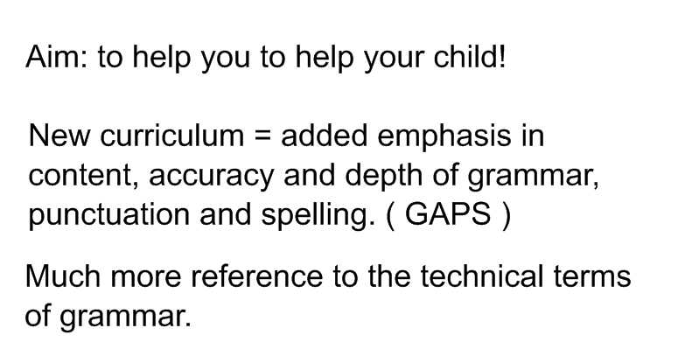

Slide 2
Examples-
Rewrite the sentence below so that it begins with the adverbial.
Use only the same words, and remember to punctuate your answer correctly.
We turned off the lights before we left.
Circle all the determiners in the sentence below.
There wasn’t much juice left in the fridge, so I bought a new bottle.
Tick one box in each row to show whether the word before is used as a subordinating conjunction or as a preposition.
We left the cinema before the end of the film.
The train ticket is cheaper before 9:00 in the morning.
I brush my teeth before I have breakfast.
Which option completes the sentence below so that it uses the subjunctive mood?
I wish I free to come to your party, but I am afraid I will be busy.
Were, could be, was, maybe

Slide 3
Most importantly children need to be able to use them -knowing what they are called is secondary.
Children need to:
Read quality texts - a range of genres and examples.
Read a lot!
Enjoy playing with sentences and words - become familiar with what sounds 'right'.
For homework be prepared to draft, edit, improve.
Realise that they are capable of improving - rise to the challenge!

Slide 4
Following are two examples of how we might develop a text over a course of a few lessons adding in improved vocabulary and phrases, reordering sentences and using more advanced punctuation.
Children need to experience quality texts frequently to build familiarity with the style, to develop their bank of ideas and develop their confidence to use these in their independent writing.

Slide 5
LO: I can make a written recount of an event.
The other day I went to the theatre. It was in Stratford upon Avon. It was a pantomime called Beauty and the Beast.
We stayed in a nice hotel and visited the town first. In the evening we went to the theatre. It was very crowded.
The play was fantastic. Everything was so colourful. I really liked the lights. The best bit was where the Ugly Sisters were booed by the audience. Some children screamed.

Slide 6
The other day I went to the theatre with some friends. It was in Stratford upon Avon, where William Shakespeare was born. It wasn't a Shakespeare play at all though but a pantomime called Beauty and the Beast. It was wonderful!
We stayed ( After we had checked in at) in a nice hotel and visited the town first( we visited the town, which was packed out). In the evening we went to the theatre. It was very crowded.( everyone seemed to be going there! )
The play was fantastic. Everything was so colourful. I really liked the lights. The best bit was where the Ugly Sisters were booed by the audience. Some children screamed.

Slide 7
The other day I went to the theatre with some friends. It was in Stratford upon Avon, where William Shakespeare was born. It wasn't a Sakespeare play at all though but a pantomime called Beauty and the Beast. It was wonderful!
We stayed ( After we had checked in at) in a nice quiet hotel, close to the centre and visited the town first( we visited the town which was packed out). In the evening, full of excitement, we went to the theatre. It was very crowded. There were masses of tourists( everyone seemed to be going there! which made us look forward to it even more! )
Eventually we found our way to our seats - good ones with a fantastic view of the stage - then the lights went down and everyone hushed.
The play was absolutelyfantastic. Everything was so colourful ( a riot of colour). I really liked the lights ( The lights were stunning ). The best bit was ( There was a wonderful moment ) where the Ugly Sisters were booed by the audience. Some children screamed ( but I thought it was hilarious).

Slide 8
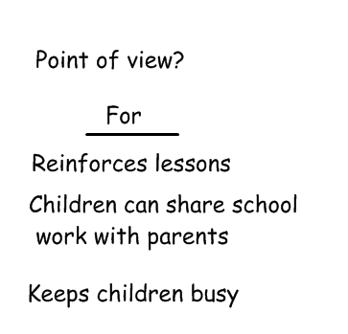
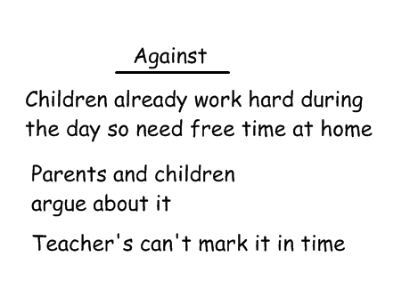
LO: I can construct a balanced discussion
( present opposing points of view about an issue )
Homework

Slide 10
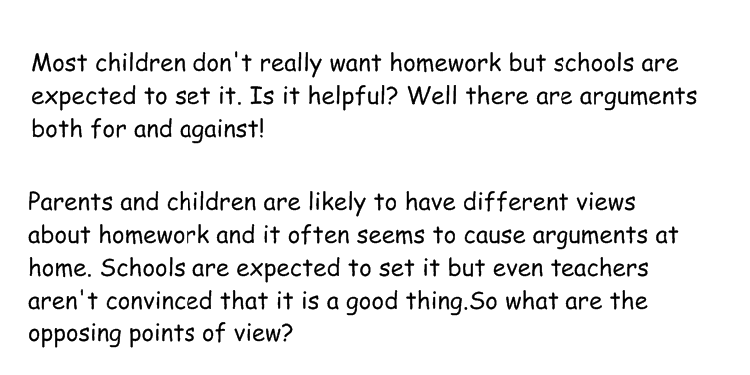

Slide 11
Lastly, a more developed example of persuasive argument relating to graffiti.

Slide 12
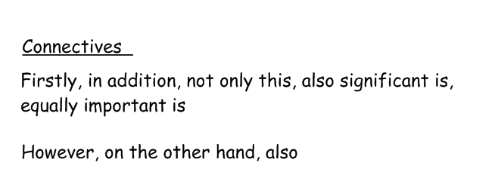
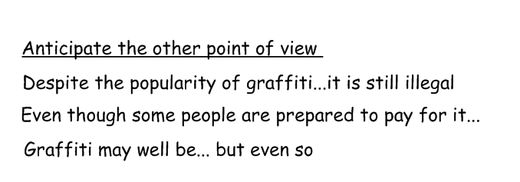

Slide 13
Graffiti is seen everywhere in our towns. Some people say it's art and others think it is just vandalism.
People for graffiti say that it is really good and fun. Some of it is but some of it isn't.
For graffiti is it is colourful and brightens up the place. And it doesn't hurt anyone and it keeps young people from getting into other trouble .
However, many others feel it spoils the environment. Sometimes it is sprayed on property and can be rude.
In addition, it is illegal. Why should people deface street signs and public walls? It's wrong and should be banned. Why can't they
So there are views on both sides. It is hard to see that everyone will agree what the best solution is.

Slide 14
Graffiti is an issue that creates strong opinions. Some people see it as art and others think it is just vandalism. But there is much more to this argument than you might think.
Those in favour of graffiti say that it is really creative; full of colour and imaginative ideas. There is no doubt that some of it is very clever.
Not only this, it is often put on ugly looking walls and brightens up the place. Furthermore it doesn't hurt anyone and it keeps young people from getting into other trouble on the streets.
However, many others feel it is ugly and spoils the environment. Sometimes it is sprayed on property and can be rude. This is a bad example to younger children.
In addition to this, it is illegal. Why should people think that they have a right to deface street signs and public walls? Can't so called graffiti 'artists' put designs on paper and show them in a gallery like everyone else?
So there are obviously strong opinions on either side. It is hard to see that everyone will agree what the best solution is.

Slide 15
There can hardly be anyone who has not noticed the growth of graffiti on our streets in recent years. Graffiti is an issue that creates extremely strong and varied opinions. Some people see it as art and others think it is just vandalism. But there is much more to this argument than you might think.
Those in favour of graffiti say that it is really creative; full of colour and imaginative ideas. There is no doubt that some of it is very clever. Nowadays the best graffiti art can sell for many thousands of pounds and the artists are becoming famous.
Not only this, those who support it claim that it is often put on previously ugly looking walls and brightens up the place. Furthermore they say it doesn't hurt anyone and it keeps young people from getting into trouble on the streets. It's a good way of directing teenagers energy and helping them to grow their creative ability.

Slide 16
However ( On the other hand ), many others feel it is ugly and spoils the environment. Sometimes it is sprayed on property and can be rude. This is a bad example to younger children. Homeowners worry that it devalues their property and puts possible homebuyers off.
In addition to this, it is illegal. Why should people think that they have a right to deface street signs and public walls? Can't so called graffiti 'artists' put designs on paper and show them in a gallery like everyone else?
So there are obviously strong opinions on either side. It is hard to see that everyone will agree what the best solution is.

Slide 17
There can hardly be anyone who has not noticed the growth of graffiti on our streets in recent years. Graffiti is an issue that creates extremely strong and varied opinions. Some people see it as art and others think it is just vandalism. But there is much more to this argument than you might think.
Those in favour of graffiti say that it is really creative; full of colour and imaginative ideas. There is no doubt that some of it is very clever. Nowadays the best graffiti art can sell for a great deal of money and the artists are becoming famous. A painting by the secret artist 'Banksy'recently sold for £20,000.
Not only this, those who support it claim that it is often put on previously ugly looking walls and brightens up the place. For example it can be used to entertain or inform the public if it is put on boards outside construction work. Furthermore they say it doesn't hurt anyone and it keeps young people from getting into trouble on the streets. It's a good way of directing teenagers energy and helping them to grow their creative ability.

Slide 18
However ( On the other hand ), many others feel it is ugly and spoils ( can have a devastating impact on ) the environment. Sometimes it is sprayed on property and can be rude and offensive. This is a bad example to younger children. Homeowners worry that it devalues their property and puts possible homebuyers off. Dacorum Council estimates that property values could rise by 10% - 20% if areas were kept clean and tidy.
In addition to this, it is illegal. Why should people think that they have a right to deface street signs and public walls? Can't so called graffiti 'artists' put designs on paper and show them in a gallery like everyone else? There is no doubt that some graffiti is of a high quality and surely people would be prepared to pay to see it?
So there are obviously strong opinions on either side. It is hard to see that everyone will agree what the best solution is but it must be resolved. Perhaps clearer or stronger laws need to be made by Parliament.

