Slide 1
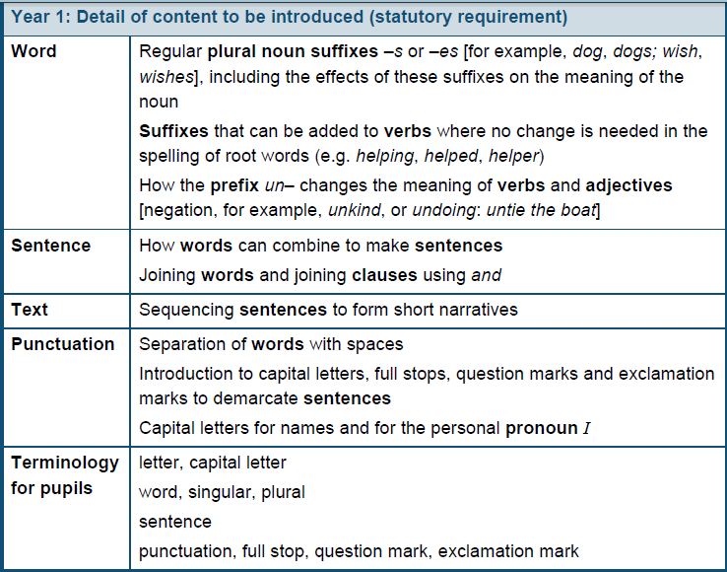
Grammar and Punctuation End of year 1:

Slide 2
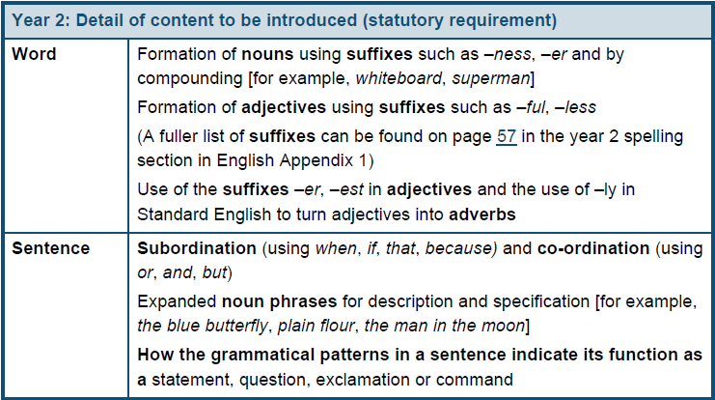
Grammar and Punctuation

Slide 4
RWI
Read write inc.
Phonics and reading scheme
Phonics is taught in daily sessions
New sounds taught daily
Books progress in line with sounds

Slide 5
Get spelling
Follows on from Read write inc. phonics
Explores spelling conventions
Shift from traditional weekly test to daily teaching and peer/self assessment
Child orientated activities
Personalised spelling log

Slide 6
Activity
Dots, dash and smile the words on the task cards
Dot: one sound - one letter
c p a h
Dash: one sound - group of letters
sh ee igh ear
Smile: one sound - two letters separated
i e a e u e

Slide 7
Phonic Screening Check
June 2016
All of year 1 (and those who didn’t meet the required score in yr2)
Need 32/40

Slide 12
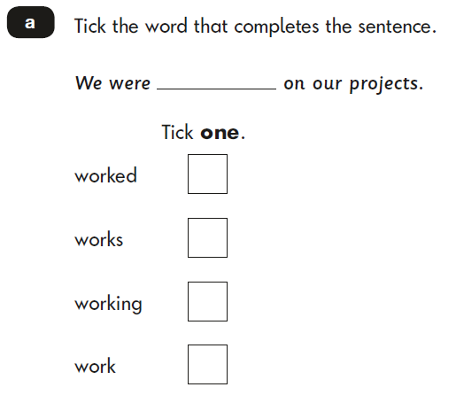
Tests
The main purpose of statutory assessment is to ascertain what pupils have achieved in relation to the areas of the national curriculum (2014) This is to inform teacher judgement.
Spelling – children listen to the teacher and fill in the missing word. Approx. 15 mins
English, punctuation and grammar – children read the questions and use their knowledge to answer questions. Approx. 20 mins

Slide 13
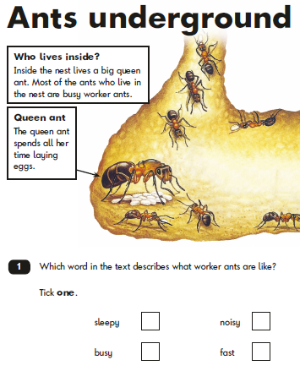
Reading
Paper 1 – text and questions. Approx. 30 mins plus introduction time
Paper 2 – longer piece of text and separate answer book. Approx. 40 mins plus introduction time
Teachers can stop a child at any point at their own discretion.

Slide 14
Questions

Slide 15
Maths

Slide 16
Maths Curriculum Teachers should develop pupils’ numeracy and mathematical reasoning in all subjects so that they understand and appreciate the importance of mathematics. Pupils should be taught to apply arithmetic fluently to problems, understand and use measures, make estimates and sense check their work. Pupils should apply their geometric and algebraic understanding, and relate their understanding of probability to the notions of risk and uncertainty. They should also understand the cycle of collecting, presenting and analysing data. They should be taught to apply their mathematics to both routine and non-routine problems, including breaking down more complex problems into a series of simpler steps. National curriculum 2014

Slide 17
Aims
The national curriculum for mathematics aims to ensure that all pupils:
▪ become fluent in the fundamentals of mathematics, including through varied and frequent practice with increasingly complex problems over time, so that pupils develop conceptual understanding and the ability to recall and apply knowledge rapidly and accurately.
▪ reason mathematically by following a line of enquiry, conjecturing relationships and generalisations, and developing an argument, justification or proof using mathematical language
▪ can solve problems by applying their mathematics to a variety of routine and non-routine problems with increasing sophistication, including breaking down problems into a series of simpler steps and persevering in seeking solutions.

Slide 18
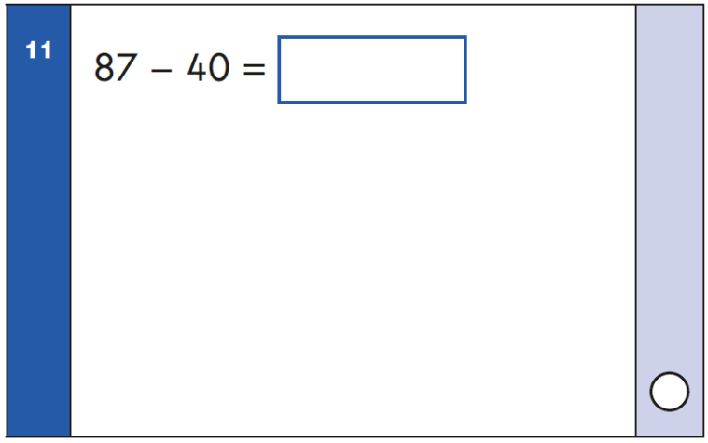
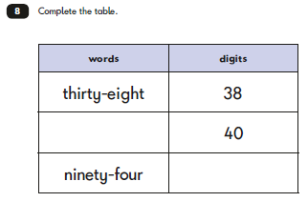
Tests Paper 1 - Arithmetic test- straight forward calculations. Approx. 20 mins Paper 2 – Reasoning test- some questions will be read by the teachers and others children need to read and solve. Approx. 35 mins

Slide 19
Practical maths
What could this show?
Have a go at the task card on your table
You need to be able to show and explain your answer using the manipulatives available or by drawing it

Slide 20
Questions

