Slide 1

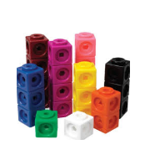
How do we calculate?
24+19=?
Supplied by Not As We Know It Limited - www.notasweknowit.co.uk

Slide 2
How do we do it?
Calculation strategies for parents
This document outlines progressive steps for teaching calculation. It then breaks these down on a year by year basis.
We hope that this document, as well as our calculation policy, will help you in supporting your children at home.

Slide 3


Reception: Addition
PRACTICAL |  | MENTAL (Jottings)
In Reception to help us with our addition we: Use small equipment to add, such as Large Dominoes Counters Fingers Multilink Number lines Number Fan Bead strings |  | Counting on in our heads Counting in 1s, 2s, and 10s One more
STANDARD |  | INFORMAL (Workings Out)
Number sentences using the + and = symbols and to represent a missing number: Numbers to 10 2 + 3 = |  | Using bowls and small equipment + = 3 + 2 = 5
5

Slide 4
Reception: Subtraction
PRACTICAL |  | MENTAL
In Reception to help us with our subtraction we: Use small equipment to add, such as Bead strings Large Dominoes Counters Fingers Multilink Number lines Number Fan Cuisenaire |  | Counting on and back Counting in 1s, 2s, and 10s Finding one less
STANDARD |  | INFORMAL (Workings Out)
Number sentences using the -- and = symbols and to represent a missing number: Numbers to 10 3 - 1 = |  | Using bowls and small equipment 3 flowers take away one = 2 At this stage it is about the physical process of taking things away
Key Objective
To begin to relate subtraction to taking away
2

Slide 5



Reception: Multiplication
PRACTICAL | MENTAL
Repeated Addition + = 2 + + + = 4 2 + 2 = 4 + + + + + = 6 | Counting on Counting in 1s, 2s, and 10s Counting 1 more Counting 5 more
STANDARD | INFORMAL (Workings Out)
Number sentences using the X and = symbols and to represent a missing number: Numbers to 10 3 x 2= | Using setting circles to make groups of small equipment How many altogether? 3 X 2 = 6 3 sets of 2 altogether is ..
Doubling numbers to 5 using fingers and mental recall
1 set of 3 is 3
6

Slide 6
Reception: Division
PRACTICAL | MENTAL
Practically sharing objects/ small equipment. Not only in maths lessons but also during continuous provision. | Counting on Counting in 1s, 2s, and 10s Counting 1 more Counting 5 more
STANDARD | INFORMAL (Workings Out)
Number sentences using the ÷ and = symbols and to represent a missing number: 10 ÷ 2 = 5 6 ÷ 2 = 3 | Using small equipment in bowls during snack time – practical activities. 10 balls; share between 2 children equally. One for you, one for me, etc.
Halving numbers to 10 using fingers and mental recall
8 sweets shared by 4 children is 2 sweets each.

Slide 7

Year 1: Addition
PRACTICAL | MENTAL
Use of number lines, 100 square, fingers, number fans, counters and small equipment. + 4 = 9 + | Number bonds to 20 Counting in steps of 1s, 2s, 5s, and 10s Recall doubles of all numbers to al least 20 Addition facts for totals to at least 20 Addition can be done in any order Multiples of 1s, 2s, 5s, 10s Find the difference (the gap between the numbers) Solve practical word problems, involving additions to 10 and then 20.
STANDARD | INFORMAL
Number sentences to 20 + 4 = + 7 = 10 + = 17 Find the missing = 3 + 14 numbers | Jane had 3 balls. She was given 2 more. How many balls does she have now? + 3 + 2 = 5

Slide 8
Year 1: Subtraction
PRACTICAL | MENTAL
Use of Number Lines; 100 square, fingers, number fans, counters and small equipment. | Halve numbers to 20 Subtraction of a one digit number or two digit number and a multiple of 10 from a two digit number Number facts subtraction to at least 5 Count back in 1s, 2s, 5s, and 10s Number bonds to 10
STANDARD | INFORMAL
Number sentences using – and = signs 10 – = 6 - 3 = 7 10 + 5 = | There are 20 children in our class. Three are away today. How many are here? 20 – 3 = 17 I I I I I I I I I I I I I I I I I I I I
10 – 1 =
10 – 2 =
Using Fingers
Use a hundred
Square to make
1 less
10 less

Slide 9

Year 1: Multiplication
PRACTICAL | MENTAL
Setting hoops = 9 Repeated Addition Unifix towers - make a double | Chanting in steps of 1s, 2s, 3s, 5sx, and 10s Quick recall of all doubles to 20
STANDARD | INFORMAL
0, 5,__, __, 20 double 2 = 4 2+ 2 = 4 | There are three ducks in three different ponds. How many ducks altogether? + + + + = 10p
Use of 100 square,
Number fans,
Counters and small equipment
xxx
xxx
xxx
Use fingers
2p
2p
2p
2p
2p

Slide 10
Year 1: Division
PRACTICAL | MENTAL
Setting hoops Sharing out counters, cubes and other small equipment Equal amounts in each group Use a scarf, fold it in half, then in quarters | Halving numbers up to 20 (the opposite of doubling)
STANDARD | INFORMAL
Key Objective To begin to share objects into equal groups and count how many in each group | Find half of 8 Share 10 strawberries between 2 children
0000
0000

Slide 11
Year 2: Addition
PRACTICAL | MENTAL
Use of number lines, 100 square, fingers, fans counters and small equipment. 21 + 7 = 28 | Number bonds to 20 Number bonds to 50 (more able) Counting in 2s, 5s and 10s Doubles to 20 (then to 50 for more able) Number bonds of multiples of 10 Knowing to put the largest number first in addition
STANDARD | INFORMAL
Number sentences to 100 using the + and = signs + 15 = 30 15 + = 30 15 + 15 = | 30 + 8 = 38
Use 100 square to add 10; add 9 and add 11quickly.
21
17
Use partitioning
21 + 17 = 38
21 + 17 =
20 + 10 1 + 7
30 + 8
38
20
1
10
7
20
10
1
7

Slide 12
Year 2: Subtraction
PRACTICAL | MENTAL
Use of number lines, 100 square, fingers, fans counters and small equipment. 21 - 7 = 14 | Counting backwards in 1s, 2s, 5s, and 10s Subtraction facts within 10 Subtraction facts within 20 (within 50 for more able children) Halving to 20 Subtraction facts of multiples of 10
STANDARD | INFORMAL
Number sentences within 100 using the - and = signs - 10 = 5 15 - = 5 15 - 10 = | -- -- 20 + 3 = 23
Quick ways to
Subtract 10
Subtract 9
Subtract 11
Using a 100 square
35
12
Example shows use of
arrow cards to aid with
subtraction calculations
30
5
10
2
30
10
5
2

Slide 13

Year 2: Multiplication
PRACTICAL | MENTAL
2 sets of 2 = 4 Making sets Using equipment to multiply | Counting in 2s, 5s and 10s Doubling to 20 (to 50 for more able) Multiples of 2s, 5s and 10s (and for 3s for more able) Knowing that multiplication is the reverse of division
STANDARD | INFORMAL
2 x 3 = 6 10 + 10 is the same as 2 x10 2x, 5x, and 10x tables ( plus 3x for more able) | There are 4 ponds and each pond has 5 ducks. How many ducks altogether?
0 0
0 0
Children physically do the problem and then
draw it out.

Slide 14
Year 2: Division
PRACTICAL | MENTAL
Practical dividing using equipment 4 dived by 2 | Counting in 2s, 5s, and 10s Halving Knowing that division is the reverse of multiplication.
STANDARD | INFORMAL
60 ÷ 10 = 6 | There are 25 pencils in each class shared equally between 5 pots.
Children physically do the problem,
then draw it out.

Slide 15
Year 3: Addition
PRACTICAL | MENTAL
100 + 20 + 2 = 122 | Using a number line 57 + 86 +50 +4 +3 __________________________________________ 86 136 140 143
STANDARD | INFORMAL
176 +48 ------ 100 110 14 ------ 224 | 83 42 ------- 120 5 ------- 125
Start with the larger
number, partition the
smaller number 57 into
tens and units and count
on the multiples of 10 first
and then the units.
Use apparatus
to help with
your calculation
100
20
2
Line up units with units
Line up tens with tens
(100 + 0
70 + 40
6+ 8
Add tens and units:
Begin with the most
significant digit.

Slide 16
Year 3: Subtraction
PRACTICAL | MENTAL
86 - 34 = 52 | Using a number line 54 -28 +2 +20 +4 28 30 50 54 = 26
STANDARD | INFORMAL
54 – 28 Decomposition 50 54 = 40 + 14 -28 = 20 + 8 20 + 6 = 26 | Compensation 54 – 28 54 -28 24 (54 -30) + 2 (since 30 -28 = 2) 26
Count forward on a
number line from the
smaller number to
find the difference
Physically
subtract 34
from 86
using
equipment
Round 28 to
the nearest 10
which is 30

Slide 17
Year 3: Multiplication
PRACTICAL | MENTAL
3 x 4 Sets of numbers using multilink or counters Multiplication arrays, eg, 3 rows of of 4 squares (or counters) 3 x 4 = 12 | Quick recall of multiples 2s, 3s, 4s, 5s,, 6s, 7s, 8s, 9s and 10s Halving and doubling of numbers up to 1000 Quick recall of 2x, 3x, 4x, 5x, 6x, 7x, 8s, 9s and 10s tables
STANDARD | INFORMAL
Standard working out is recorded vertically 4 3 X3 X4 12 12 | Repeated addition = 4 x 3= 12, 4 + 4 + 4 = 12 Recall multiplication fact to answer questions, eg, 6 x 24 = Fill in the missing number 8 x = 40 To know that division is the inverse of multiplication

Slide 18
Year 3: Division
PRACTICAL | MENTAL
Sharing sets of numbers. Using multilink or counters | Rapid recall of halves and doubles to 1000
STANDARD | INFORMAL
26 ÷ 3 = 8 r 2 1x 3 2x3 3x3 4x3 5x3 6x3 7x3 8x3 r2 0 3 6 9 12 15 18 21 24 26 | To remember the inverse of division is multiplication 24 ÷ 3 = Remember 8 x 3 = 24 So 24 ÷ 3 = 8

Slide 19
Year 4: Addition
PRACTICAL | MENTAL
100 + 50 + 2 | 999 + 637 999 + 637 1000 + 637 = 1637 1637 -1 = 1636
STANDARD | INFORMAL
H T U 4 8 6 5 2 1 486 = 400 + 80 + 6 H 9 0 0 521 = 500 + 20 + 1 T 1 0 0 1007 = 900 + 100 + 7 U 7 1 0 0 7 | 1486 + 521 1000 + 900 + 100 + 7 = 2007
By making the 999 up to
1000 and then taking the 1 back later this calculation
is simple and solved in
seconds.
100
50
2
1
5
2

Slide 20
Year 4: Subtraction
PRACTICAL | MENTAL
Interactive whiteboard and pupil whiteboards 342 – 87 +3 +10 +200 +42 87 90 100 300 342 200 + 42 + 10 + 3 = 255 Count forward on a number line from the smaller number to find the difference, from 87 In this example. | 342 - 87 = 342 – 87 = 342 – 40 = 302 342 – 90 = 252 302 – 40 = 262 252 + 3 = 255 262 – 7 = 255
STANDARD | INFORMAL
342 – 87 200 130 12 23412 300 + 40 + 2 8 7 80 + 7 200 + 50 + 5 | Compensation 7000 - 470 7000 – 500 = 6500 6500 + 30 = 6530
It is more reliable
and efficient to
take away the 500,
then add the 30
back on after.

Slide 21
Year 4: Multiplication
PRACTICAL | MENTAL
Interactive whiteboard programme of array boards and using multilink blocks. | A Tyrannosaurus Rex was approximately 15 times as long as the largest lizard. A lizard’s tail is 60cm long. How long was the tail of the Tyrannosaurus Rex? Repeated addition 60 + 60 + 60 + 60 + 60 + 60 + 60 + 60 + 60 + 60 + 60 + 60 + 60 + 60 + 60 = 900 cm
STANDARD | INFORMAL
Using a 2-digitnumber 60 X15 300 (5 x 60) 600 (10 x 60) | X 10cm 5cm 60 = 900cm
4 rows of 5
= 20
Using a single
digit number
60
X5
300
600 300

Slide 22
Year 4: Division
PRACTICAL | MENTAL
Multilink blocks sharing into groups | 74 ÷ 5 = 14 r 4 50 20 4 10 x 5 4 x 5 10 x 5 4 x 5 0 50 70 74 14 x 5 + 4 = 14 r 4
STANDARD | INFORMAL
78 ÷ 3 = 26 3 78 60 (20 x 3) 18 18 0 | 86 ÷ 5 Calculate Approximate 50 ÷ 5 = 10 86 100 ÷ 5 = 20 - 50 (10 x 5) 86 lies 36 between 10 - 35 (7 x 5) and 20 1 Answer 17 remainder 1

Slide 23
Year 5: Addition
PRACTICAL | MENTAL
The train left the station at 12.40pm and arrived at its destination at 4.38pm. How long did the journey take? 56min + 3 hours + 38min 12.04pm 1pm 4pm 4.38pm (38 – 4 = 34 min) 56 + 4 = 1 hour; 3hrs + 1 hr = 4 hrs. Total Journey time = 4 hours 34 mins | 126 + 93 100 + 90 +20 + 6 +3 100 +110 +9 = 219
STANDARD | INFORMAL
 | 7587 + 5675 12000 (7000 + 5000) 1100 (500 + 600) 150 (80 + 70) 12 (7 +5) 13262
7 + 6 = 13, place the 3 in the units column and carry the ten forward to the tens column.
50 + 20 + 70 + the carried forward 10 = 80
Place the 80 in the tens column.
400 + 900 =1300, place the 3 in the hundreds column and carry the thousands.
1 (1000) add the carried thousand = 2000
T H T U
1 4 5 7
+ 9 2 6
2 3 8 3
1 1
Add the
most
significant
digits first:
In this example,
thousands

Slide 24
Year 5: Subtraction
PRACTICAL | MENTAL
Use of interactive whiteboard and number lines on whiteboards 419 -297 = 122 +3 +100 +19 297 300 400 419 | Find the difference between 296 and 854 296 + 4 = 300 300 + 500 = 800 4 + 500 + 54 = 558 800 + 54 = 854
STANDARD | INFORMAL
1 5 3 1 6476 -2684 3792 | 2410 – 482 = 1000 +1300 +100 +10 - 400 + 80 + 2 1000 + 900 + 20 + 8 = 1928

Slide 25
Year 5: Multiplication
PRACTICAL | MENTAL
All tables must be known by heart, and children should respond instantaneously when asked any table fact. They should use these facts to work out other multiplication facts: 9 x 7 i.e. Find 10 x then take off one group of 7. i.e. The inverse of 6 x 8 + 48 is 48 ÷ 8 = 6 | The class wants to make 275 spiders for a display. How many legs do they need to make? 275 x 10 = 2750 or 300 x 8 = 2400 275 x 2 = 550 25 x 8 = 200 2750 -550 = 2200 2400 -200 =2200 Or 275 doubled is 550 550 doubled is 1100 1100 doubled is 2200
STANDARD | INFORMAL
275 X 8 1600 560 40 2200 | A grid method might be used which emphasises the number as a whole rather than individual digits. X 200 70 5 8
Leading
to
275
X 8
2200
1600
560
40
2200
200 70 5

Slide 26
Year 5: Division
MENTAL | MENTAL & JOTTINGS
Estimate 234 ÷ 9 = My estimation is 25 because I rounded up 234 to 250 and 9 to 10 250 ÷ 10 = 25 | 570 ÷ 2 = (500 ÷ 2) + (70 ÷ 2) = 250 + 35 = 285 Partition then recombine
STANDARD | INFORMAL
28 482 300 x 132 120 x 12 20 ÷ 8 = | 432 school children are going on an outing. If each bus takes 15 passengers. How many buses will be needed? Estimate first! 432 Since 400 ÷ 10 = 40 150 – 10 buses And 400 ÷ 20 = 20 282 the answer lies 150 – 10 buses between 20 and 40 132 120 – 8 buses 12 Therefore the answer is 28 with a remainder of 12. So 29 buses are needed.
28
432
300
132
120
12
or

Slide 27
Year 6: Addition
PRACTICAL | MENTAL
Use of interactive whiteboard and number lines on whiteboards. 348 increased by 136 +100 +30 +6 348 448 478 484 | Near doubles 159 + 160 150 doubled = 300 300 + 9 +10 = 319 Rounding and adjusting 219 + 341 220 + 340 = 560 Missing number calculations 76 + = 112 (Using the inverse operation) = 112 -76
STANDARD | INFORMAL
T H T U 7 4 8 6 + 3 9 2 7 1 1 4 1 3 1 1 1 | 5384 + 2729 7000 (5000 + 2000) 1000 (300 + 700) 100 (80 + 20) 13 (4 + 9) 8113
Compensation
4865
+2678
7865 (4865 +3000)
322 (3000 +2678)
7543
Add the most significant digits first:
In this example, thousands

Slide 28
Year 6: Subtraction
PRACTICAL | MENTAL
Use of interactive whiteboard and number lines on whiteboards. +3 +100 +10 +9 297 300 400 410 419 | Mental strategies taught in Year 6 include inverse operation (addition or counting up) +3 +100 +19 297 300 400 419
STANDARD | INFORMAL
1 4 3 1 5428 -2794 2634 Decomposition | Compensation (rounding and adjusting) 5345 -1767 3345 (5345 -2000) 233 (2000 – 1767) 3578
100
19
3
122
Counting up from
the lower number
5435
-1767
33 (+33=1800)
200 (+200 = 2000)
3435 (+3435 5435)
3668

Slide 29
Year 6: Multiplication
PRACTICAL |  |  | MENTAL
New strategies are introduced, such as To ‘x25’, divide by 4 then multiply by 100 36 x 25 = (36÷4) x 100 = 9 x 100 = 900 FACTORISE a multiplication, eg 36 x 42 = 36 x 6 x 7 = 216 x 7 = 1512 |  |  | Partitioning 24 x 10 = 240 24 x 16 24 x 6 = 120 + 24 240 + 120 +24 = 384
STANDARD |  |  | INFORMAL
To multiply large numbers by single digit: 4273 x 8 34184 2 5 2 Work from the right and carry. | To multiply decimals: 2.57 x 4 2.0 x 4 = 8.0 0.5 x 4 = 2.0 0.07 x 4 = 0.28 10.28 | Long multiplication 246 x 35 7000 (200 x 35) 1400 (40 x 35) 210 (6 x 35) 8610 | Grid Method 356 x 24 X 300 50 6 = 7120 +1424 20 8544 6
20 x 16 = 320
24 x 16
4 x 16 = 64
320 + 64 = 384
or
120
6000
6000
1000
1200
200
24

Slide 30
Year 6: Division
PRACTICAL |  |  | MENTAL & JOTTINGS
Estimation 23.4 ÷ 9 = My estimation is 2.5 because I rounded up 23.4 to 25 and 9 to 10 25 ÷ 10 = 2.5 |  |  | Use doubling and halving eg, to x by 50, multiply by 100 then halve 26 x 50 26 x 100 = 2600 2600 ÷ 1300
STANDARD |  |  | INFORMAL
Short Division 32 r 9 6 196 180 (30 x 6) 16 12 (2 x 6) 4 | Long Division 34 884 780 (30x26) 104 104 (4 x 26) 0 | Division of Decimals 12.5 87.5 70.0 (10 x7) 17.5 14.0 (2 x 7) 3.5 3.5 (0.5 x 7) 0 | Repeated Subtraction 128 ÷ 16 128 32 (2 x 16) 96 32 (2 x 16) 64 32 (2 x 16) 32 32 (2 x 16) = 8 0

Slide 31
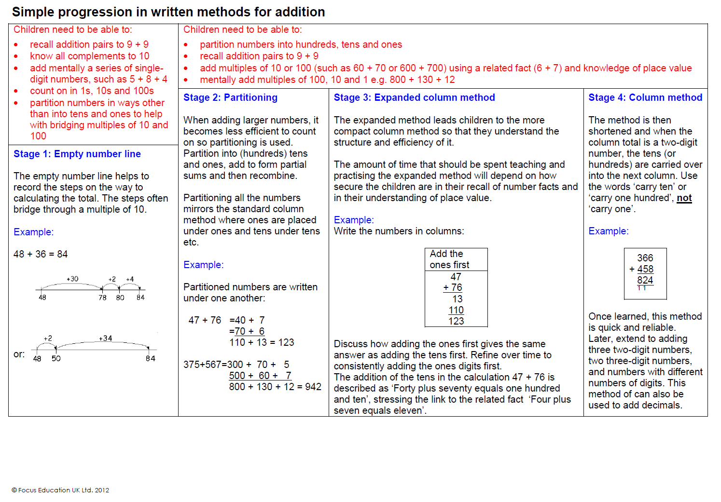

Slide 32
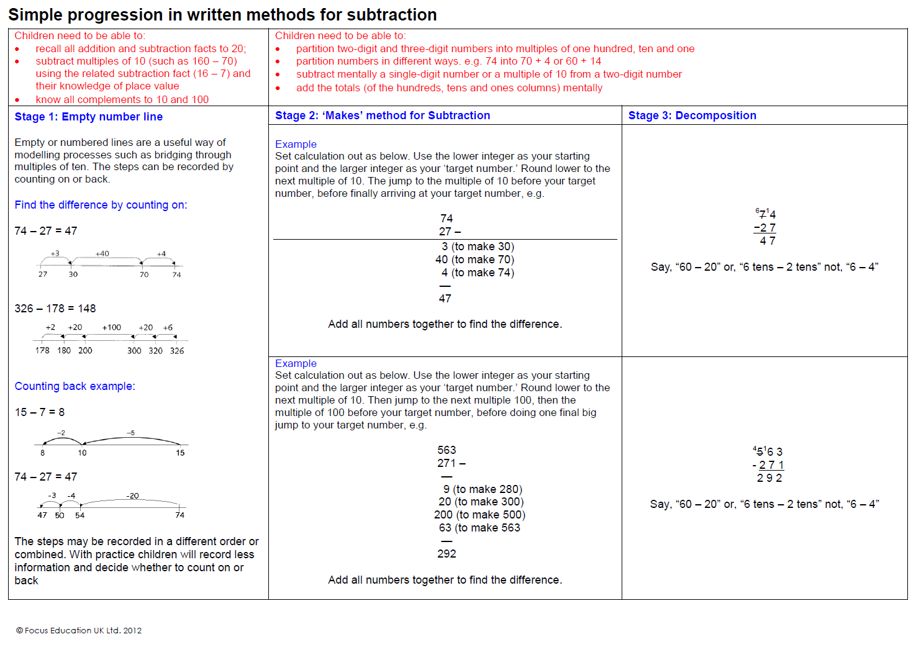

Slide 33
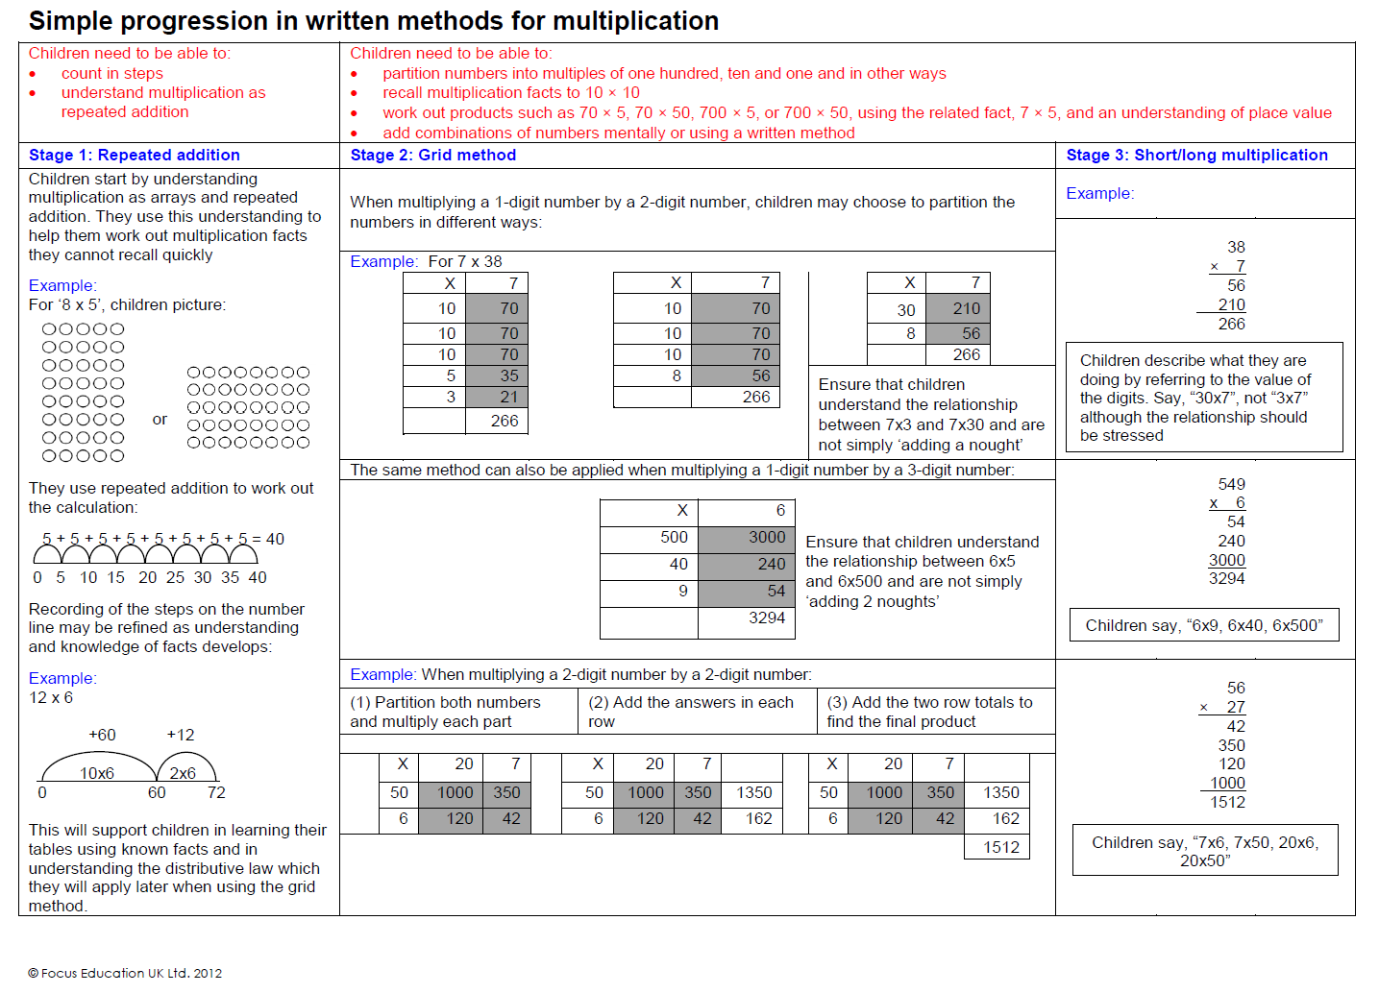

Slide 34
